Slide 1
Pandas.DataFrame

Slide 2
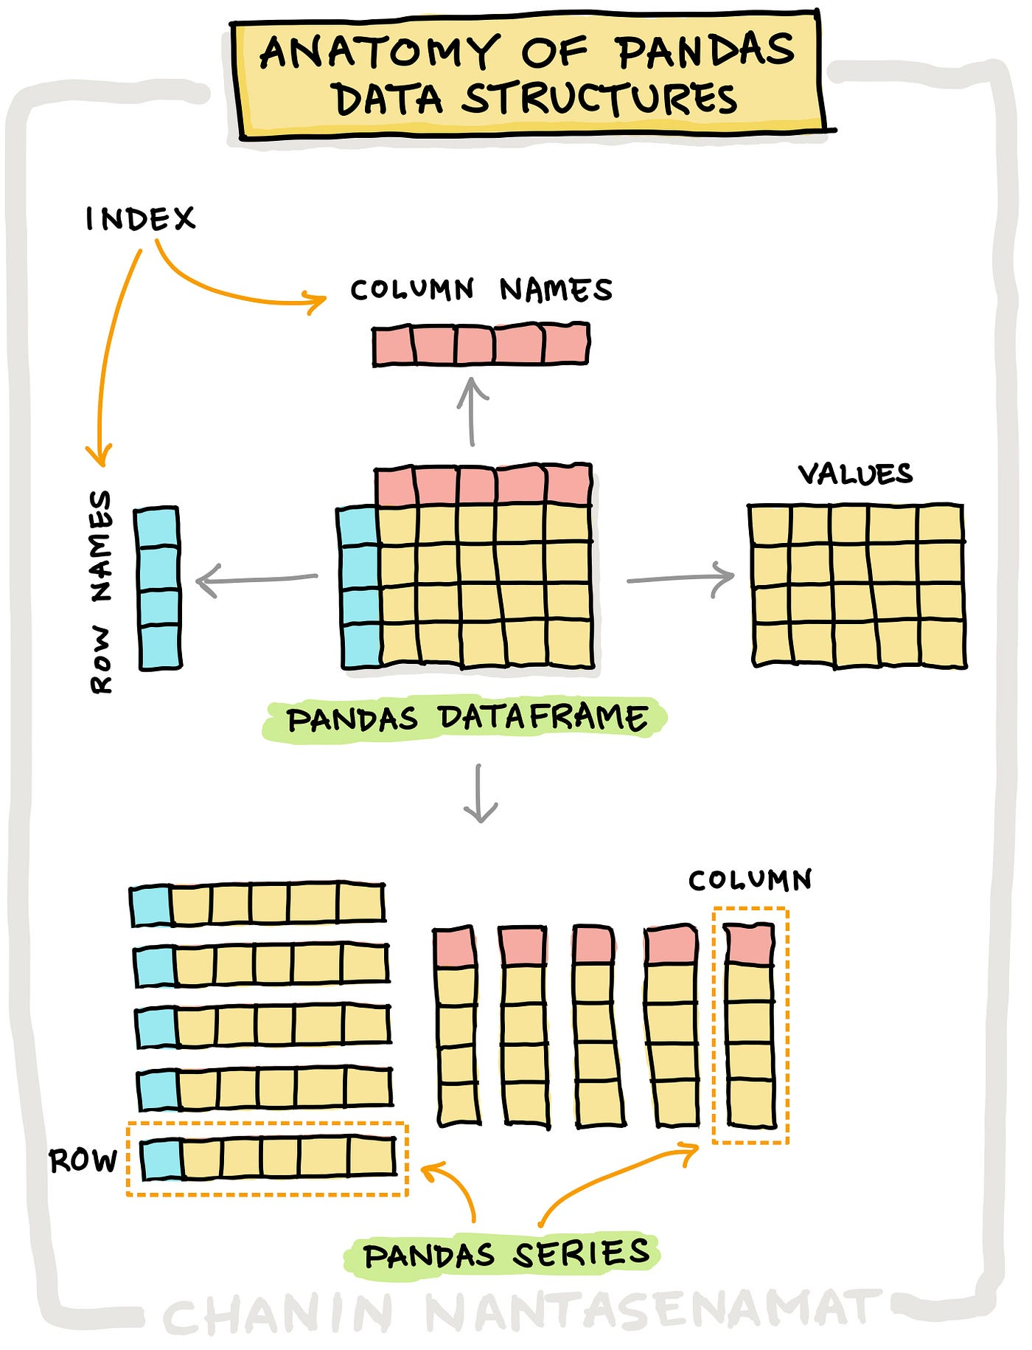
Pandas.DataFrame
We can think of a DataFrame as a bunch of Series objects put together to share the same index

Slide 3
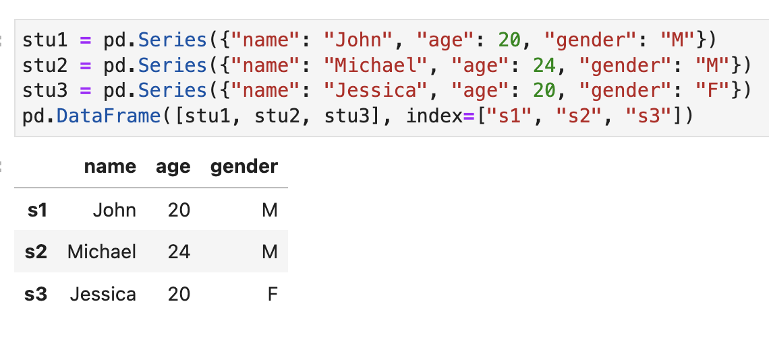
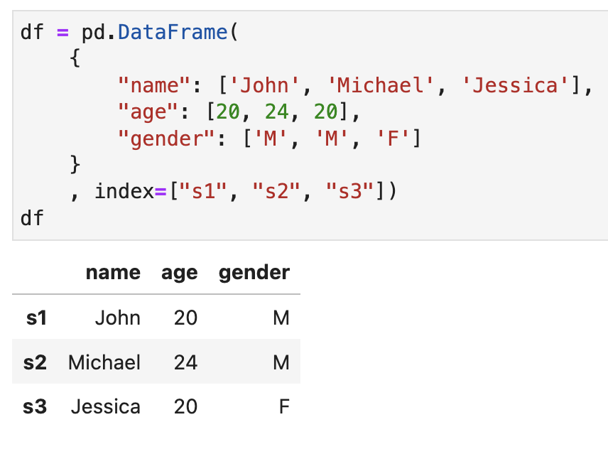
Create DataFrame from Series
Create DataFrame from dict
Pass a dict of Series — keys become column names.
Or a dict of lists — the most common way.

Slide 4
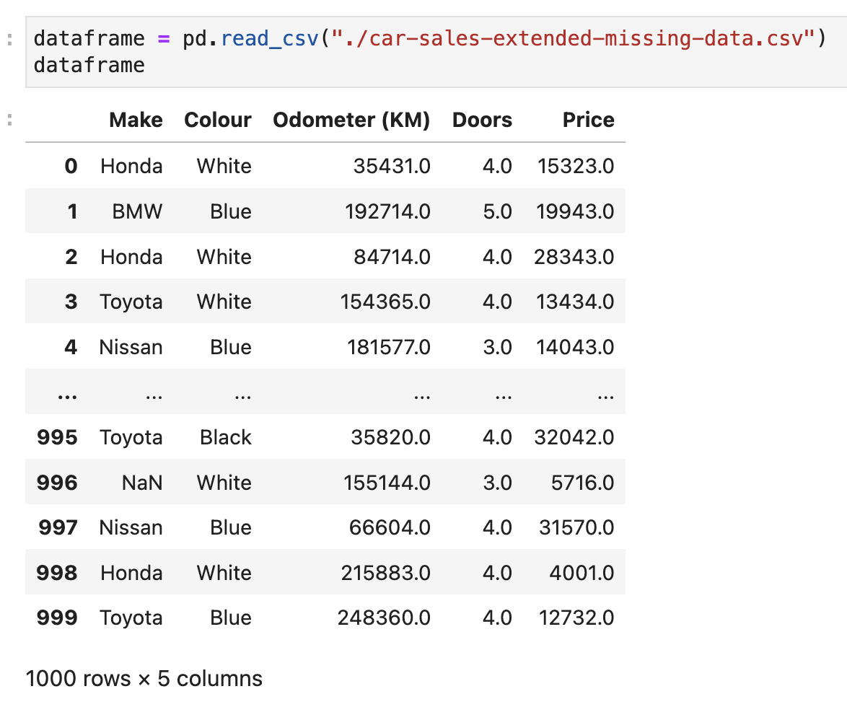
Create Pandas.DataFrame from Row-Columned file
pd.read_csv(‘file_path’) loads a comma-separated file.
pd.read_excel() / pd.read_json() handle other(excel, json) formats.

Slide 5
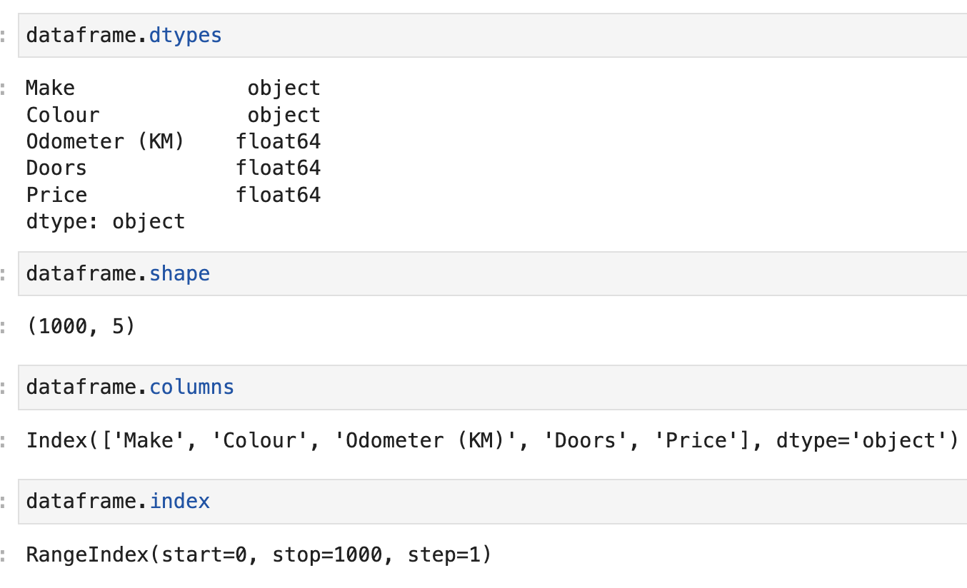
DataFrame Structure
Display DataFrame Props

Slide 6
Read / Query DataFrame

Slide 7
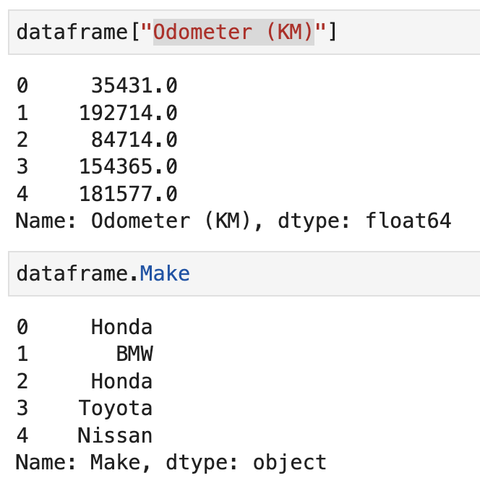
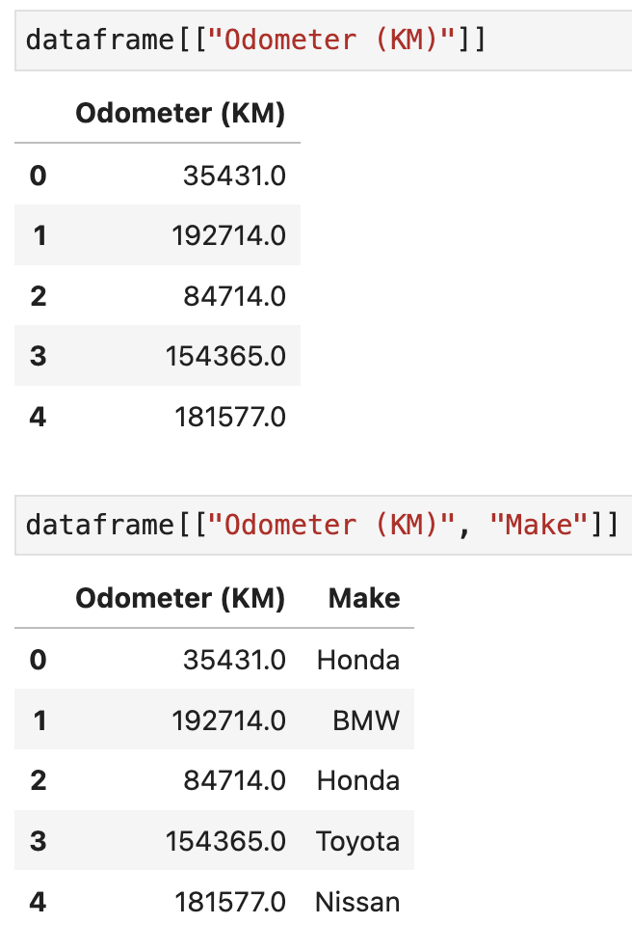
Getting a column
Getting multiple columns
Cautious: this will return Series, not Dataframe
Cautious: this will return Dataframe

Slide 8
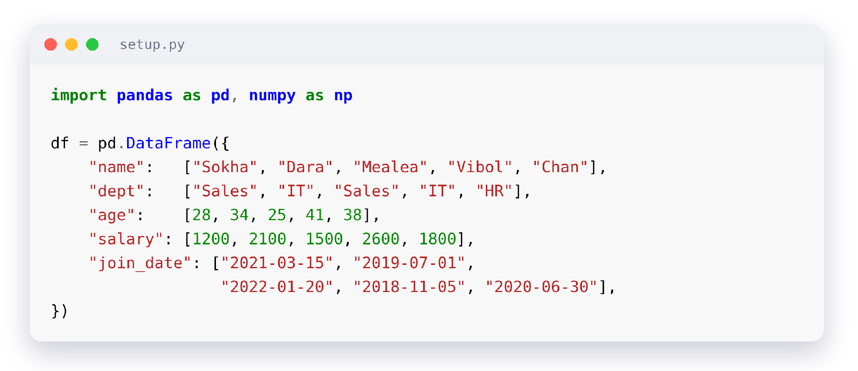
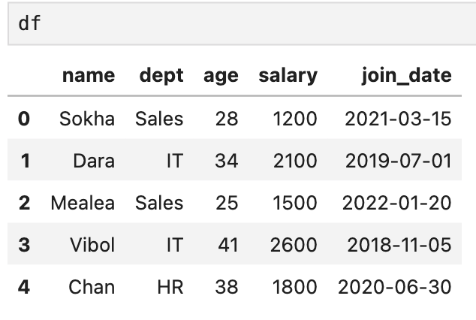
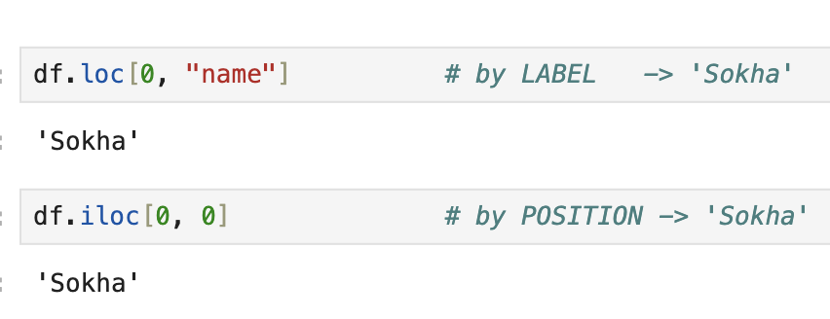
Getting data by Label & Position
LABEL VS POSITION
Two ways to point at data.
loc selects by label — the index and column names.
iloc selects by position — integer row/column number.
Notes:
import pandas as pd
import numpy as np
df = pd.DataFrame({
"name": ["Sokha", "Dara", "Mealea", "Vibol", "Chan"],
"dept": ["Sales", "IT", "Sales", "IT", "HR"],
"age": [28, 34, 25, 41, 38],
"salary": [1200, 2100, 1500, 2600, 1800],
"join_date": ["2021-03-15", "2019-07-01",
"2022-01-20", "2018-11-05", "2020-06-30"],
})
df.loc[0, "name"] # by LABEL -> 'Sokha'
df.iloc[0, 0] # by POSITION -> 'Sokha'
df.iloc[0:2, 0:3] # position slice (end-exclusive)
df.loc[df["age"] > 30, ["name", "salary"]] # mask + columns

Slide 9
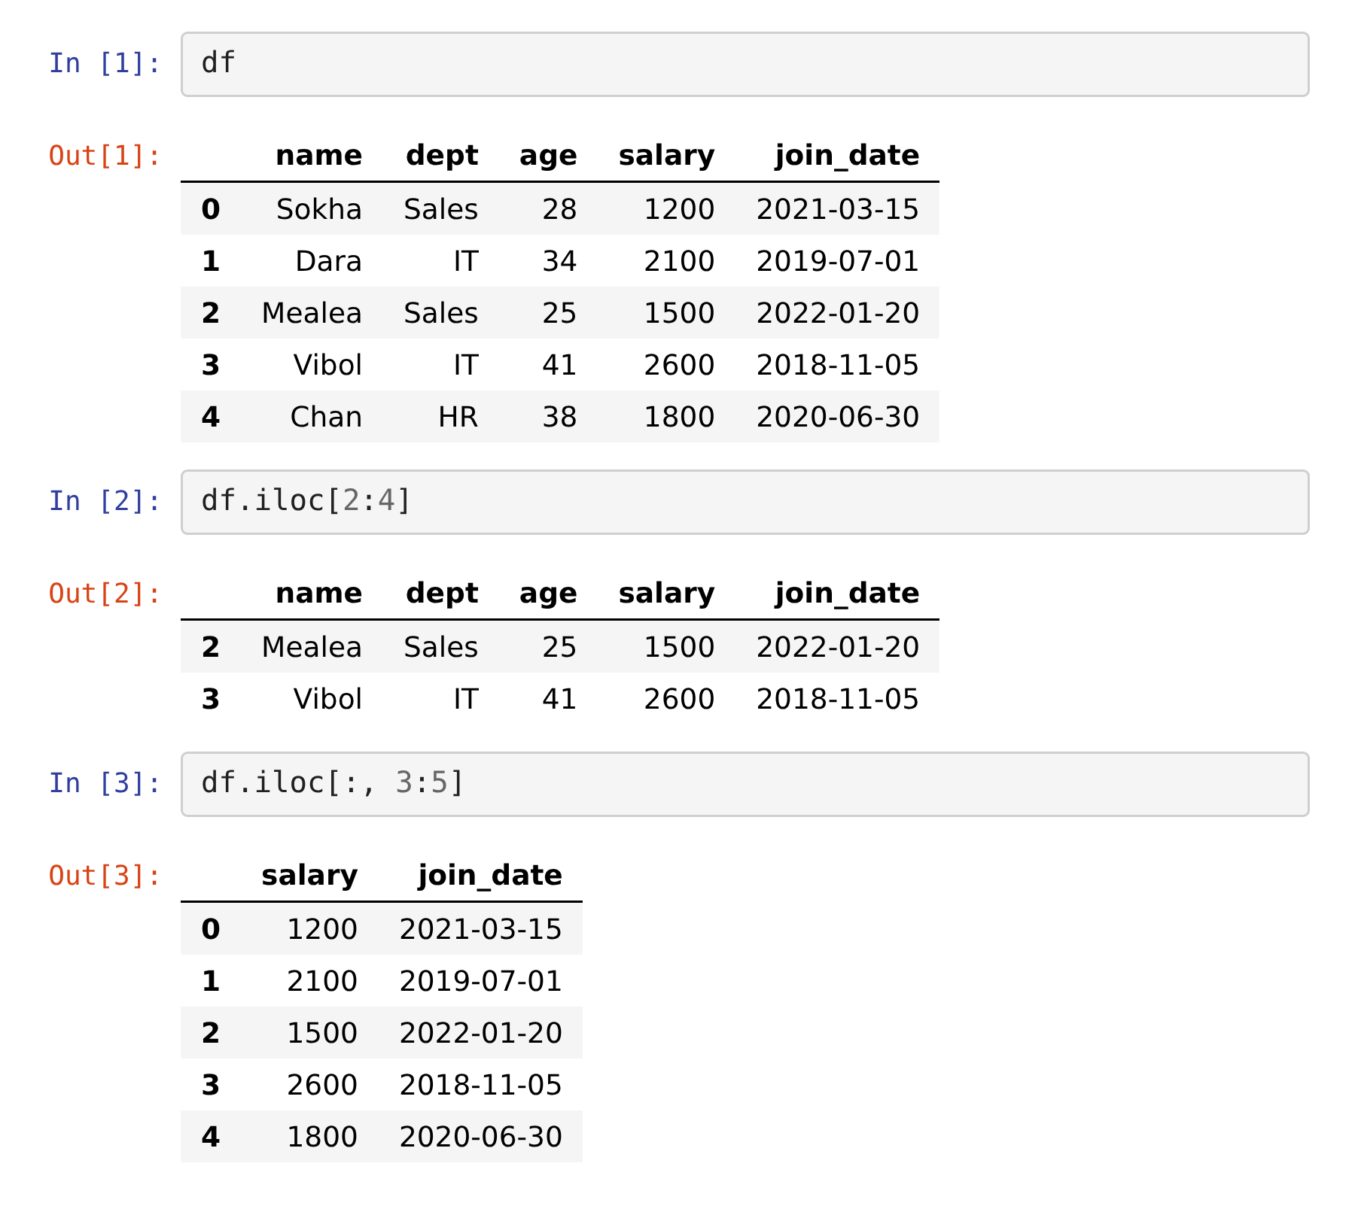
Slicing by Position
ROW & COLUMN NUMBER · iloc
● Syntax: df.iloc[row_start:row_end:step]
● Syntax: df.iloc[row_start:row_end:step, col_start:col_stop:step]
DataFrame supports slicing just like Python strings
Rows only: df.iloc[2:4] — the column part is optional
Columns only: df.iloc[:, 3:5] — a bare : keeps every row
Positions start at 0 and the end is excluded, so iloc[2:4] returns rows 2 and 3
Notes:
df
df.iloc[2:4]
df.iloc[:, 3:5]

Slide 10
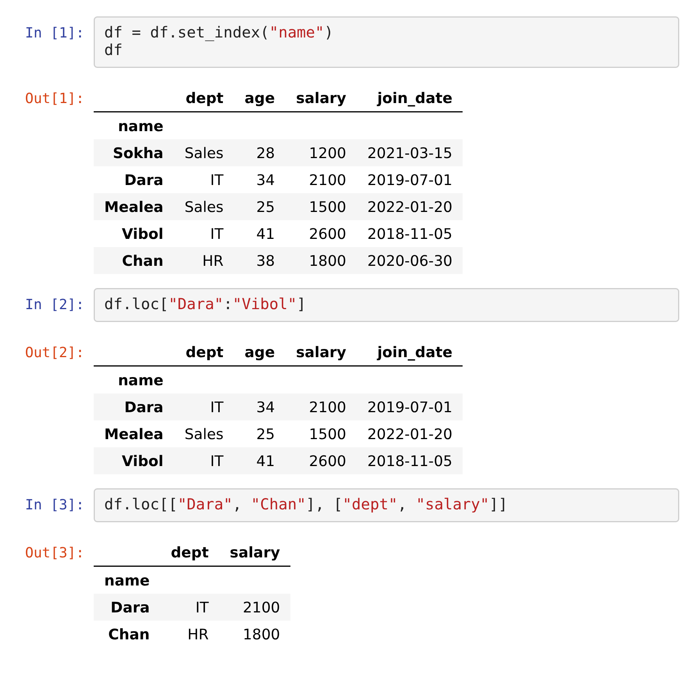
Slicing by Label
ROW & COLUMN KEY · loc
● Syntax: df.loc[row_start:row_end:step]
● Syntax: df.loc[row_start:row_end:step, col_start:col_stop:step]
Uses the index labels and column names, not positions
Slice with df.loc["Dara":"Vibol"] or pass a list of keys
Pick rows and columns together: df.loc[["Dara", "Chan"], ["dept", "salary"]]
Unlike iloc, loc includes the end label — "Vibol" is in the result
Notes:
df = df.set_index("name")
df
df.loc["Dara":"Vibol"]
df.loc[["Dara", "Chan"], ["dept", "salary"]]

Slide 11
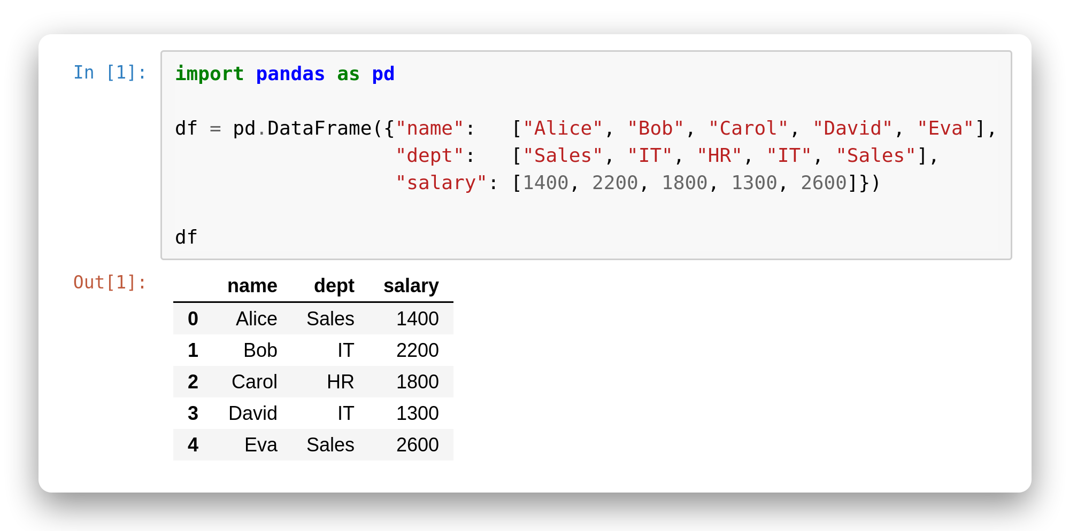
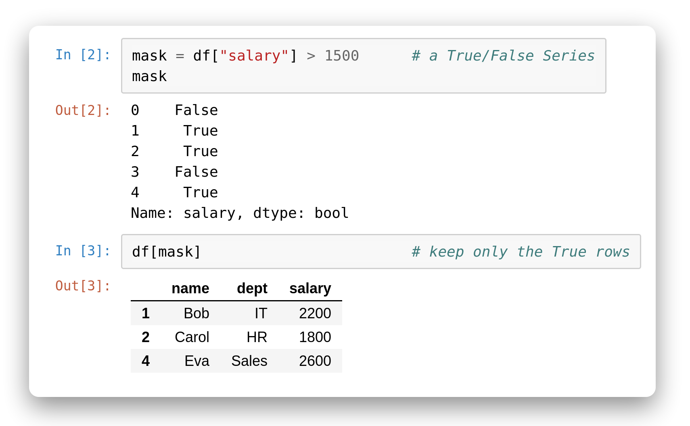
Boolean Filtering
Keep rows that match
A comparison like df["salary"] > 1500 returns a Series of True/False.
Put that mask in df[...] and Pandas keeps only the True rows.
Naming the mask first often reads more clearly.
Notes:
# In [1]
import pandas as pd
df = pd.DataFrame({"name": ["Alice", "Bob", "Carol", "David", "Eva"],
"dept": ["Sales", "IT", "HR", "IT", "Sales"],
"salary": [1400, 2200, 1800, 1300, 2600]})
df
# In [2]
mask = df["salary"] > 1500 # a True/False Series
mask
# In [3]
df[mask] # keep only the True rows

Slide 12
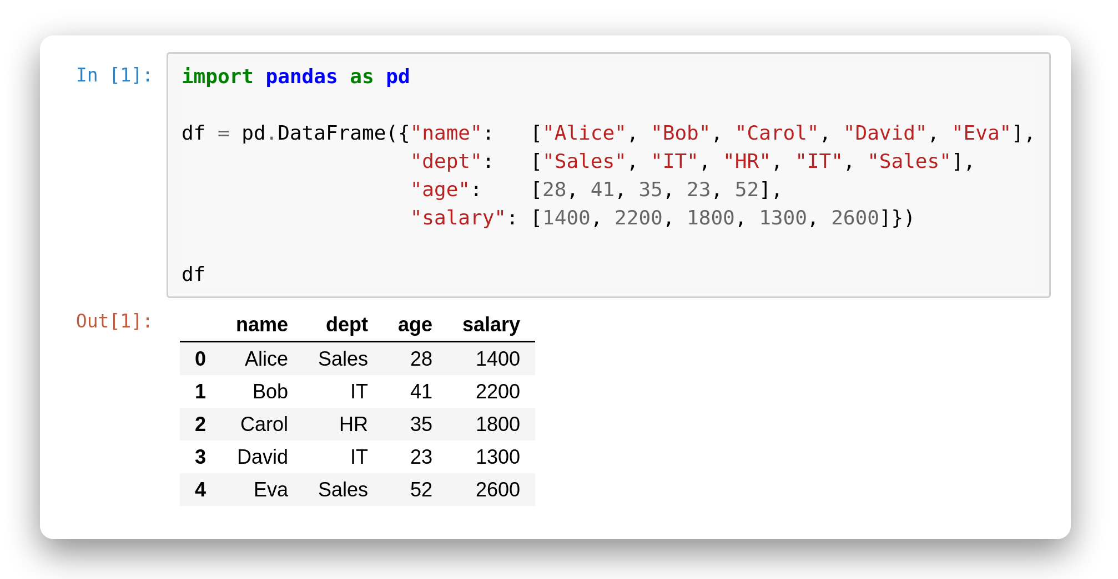
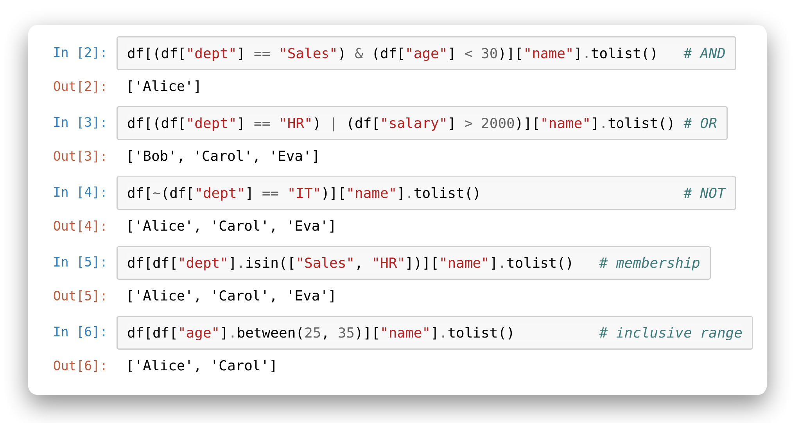
Combine Conditions
MULTIPLE CONDITIONS
Join masks with & | ~.
& = and, | = or, ~ = not — bitwise operators, not the words.
Wrap each condition in parentheses.
isin() checks membership; between() checks an inclusive range.
Insight: Forgetting the parentheses is the #1 filtering bug — Python's operator precedence breaks the mask.
7
Notes:
# In [1]
import pandas as pd
df = pd.DataFrame({"name": ["Alice", "Bob", "Carol", "David", "Eva"],
"dept": ["Sales", "IT", "HR", "IT", "Sales"],
"age": [28, 41, 35, 23, 52],
"salary": [1400, 2200, 1800, 1300, 2600]})
df
# In [2]
df[(df["dept"] == "Sales") & (df["age"] < 30)]["name"].tolist() # AND
# In [3]
df[(df["dept"] == "HR") | (df["salary"] > 2000)]["name"].tolist() # OR
# In [4]
df[~(df["dept"] == "IT")]["name"].tolist() # NOT
# In [5]
df[df["dept"].isin(["Sales", "HR"])]["name"].tolist() # membership
# In [6]
df[df["age"].between(25, 35)]["name"].tolist() # inclusive range

Slide 13
Transforming Columns
Turn existing columns into new ones with your own logic.
11

Slide 14
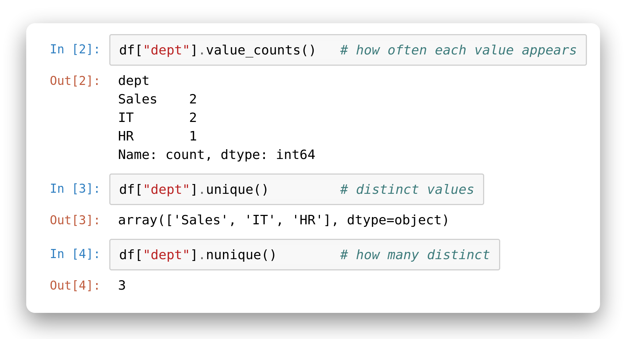
Explore a Column
First moves on any new column
value_counts() tallies how often each value appears.
unique() lists the distinct values.
nunique() counts how many distinct values there are.
Notes:
# In [1]
import pandas as pd
df = pd.DataFrame({"name": ["Alice", "Bob", "Carol", "David", "Eva"],
"dept": ["Sales", "IT", "HR", "IT", "Sales"],
"salary": [1400, 2200, 1800, 1300, 2600]})
df
# In [2]
df["dept"].value_counts() # how often each value appears
# In [3]
df["dept"].unique() # distinct values
# In [4]
df["dept"].nunique() # how many distinct

Slide 15
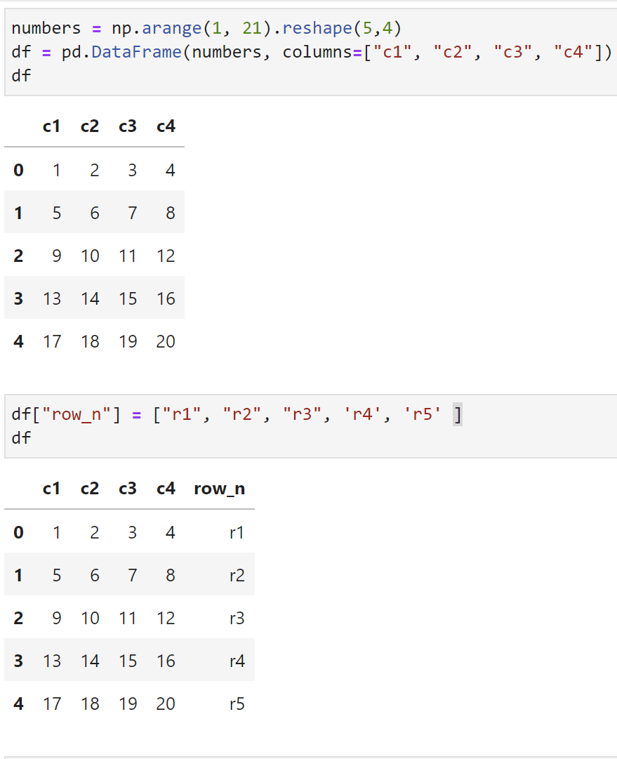
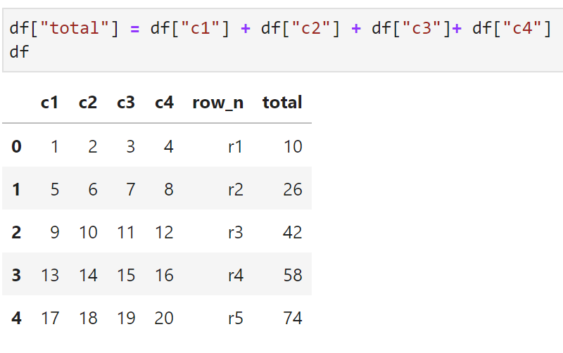
Create / Update new column
Create / Update new column by other column

Slide 16
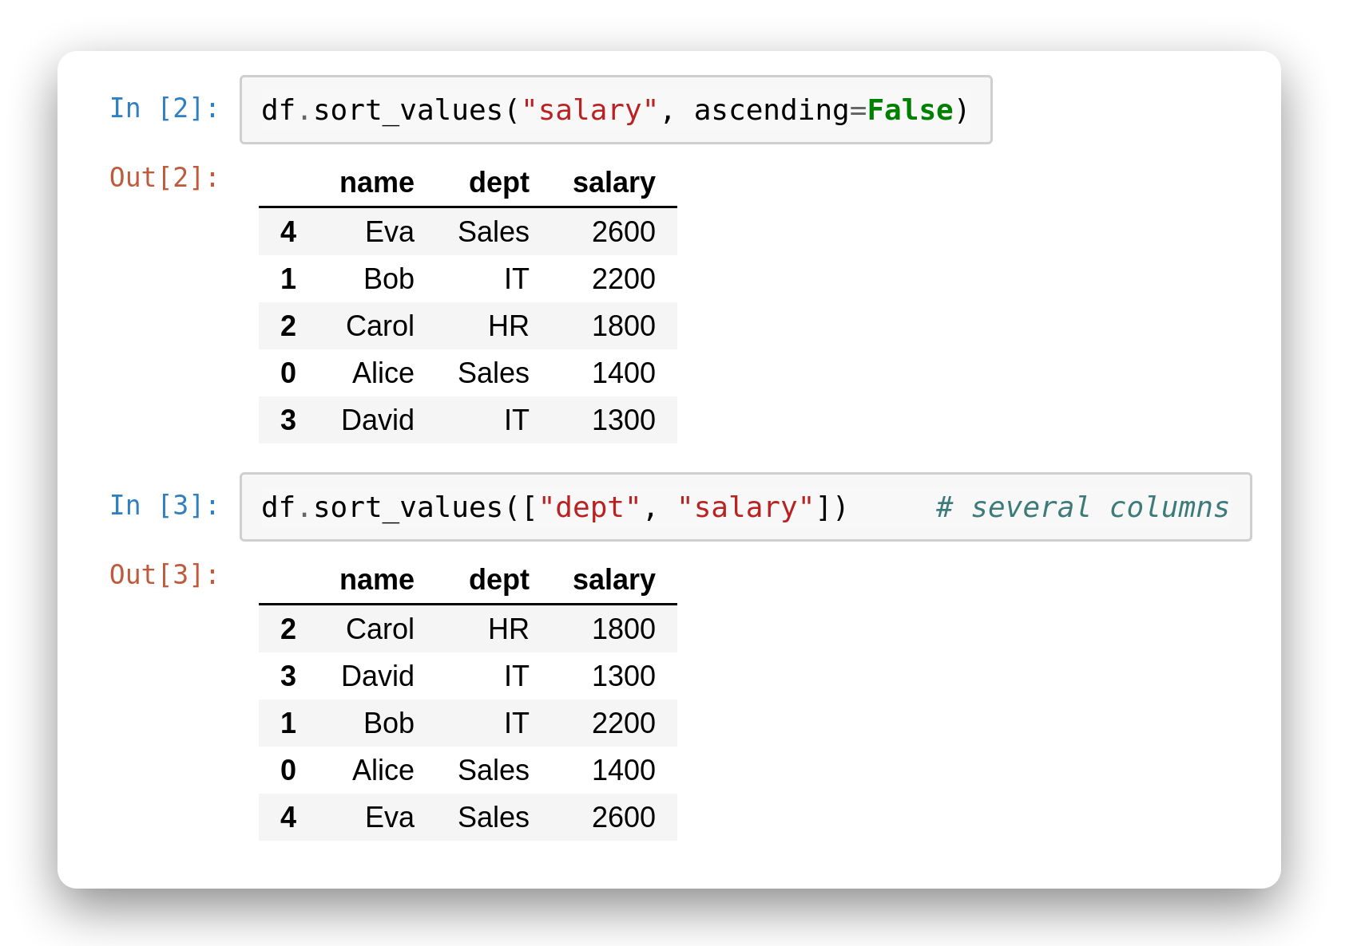
Sort Values
Order the rows
sort_values() orders rows by one column.
ascending=False puts the biggest first.
Pass a list to sort by several columns — ties fall to the next key.
Notes:
# In [1]
import pandas as pd
df = pd.DataFrame({"name": ["Alice", "Bob", "Carol", "David", "Eva"],
"dept": ["Sales", "IT", "HR", "IT", "Sales"],
"salary": [1400, 2200, 1800, 1300, 2600]})
df
# In [2]
df.sort_values("salary", ascending=False)
# In [3]
df.sort_values(["dept", "salary"]) # several columns

Slide 17
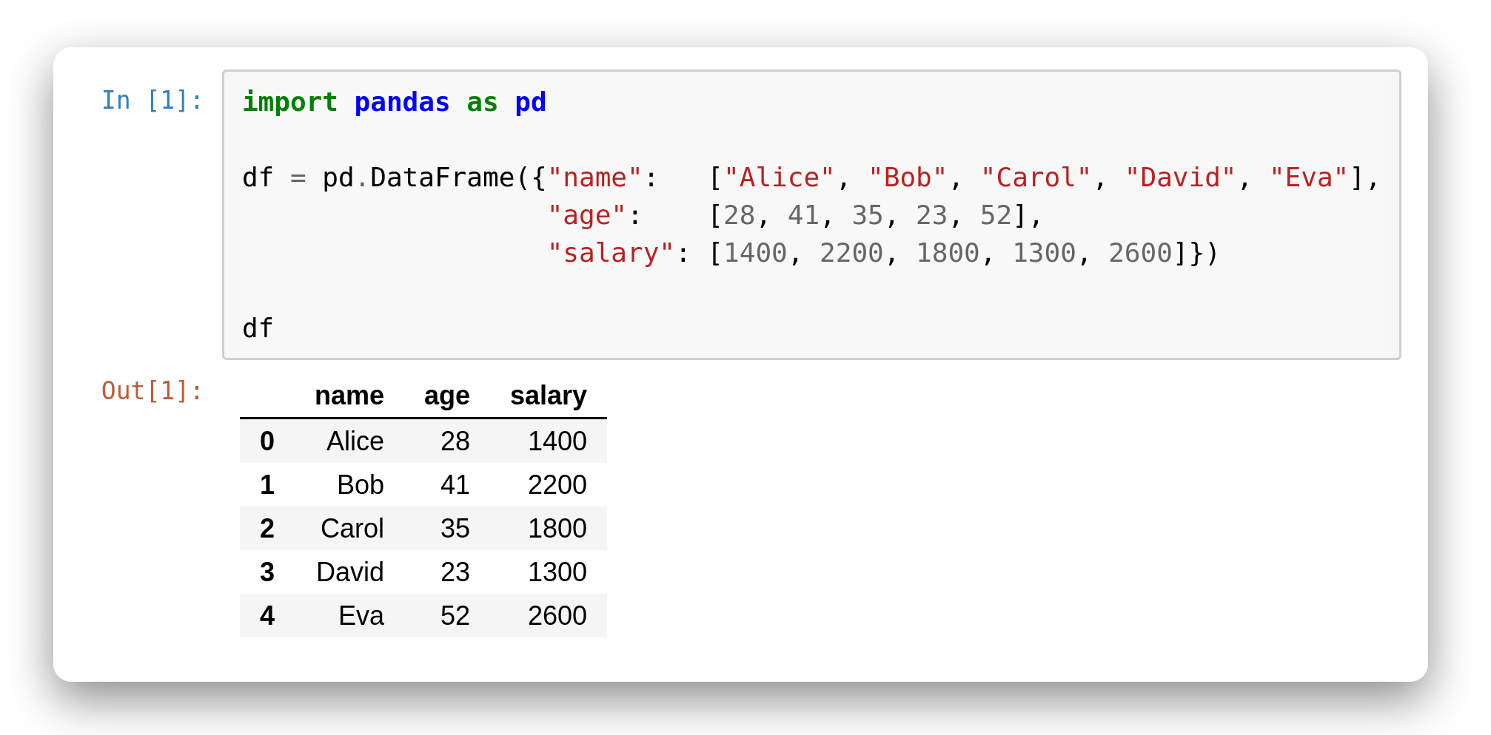
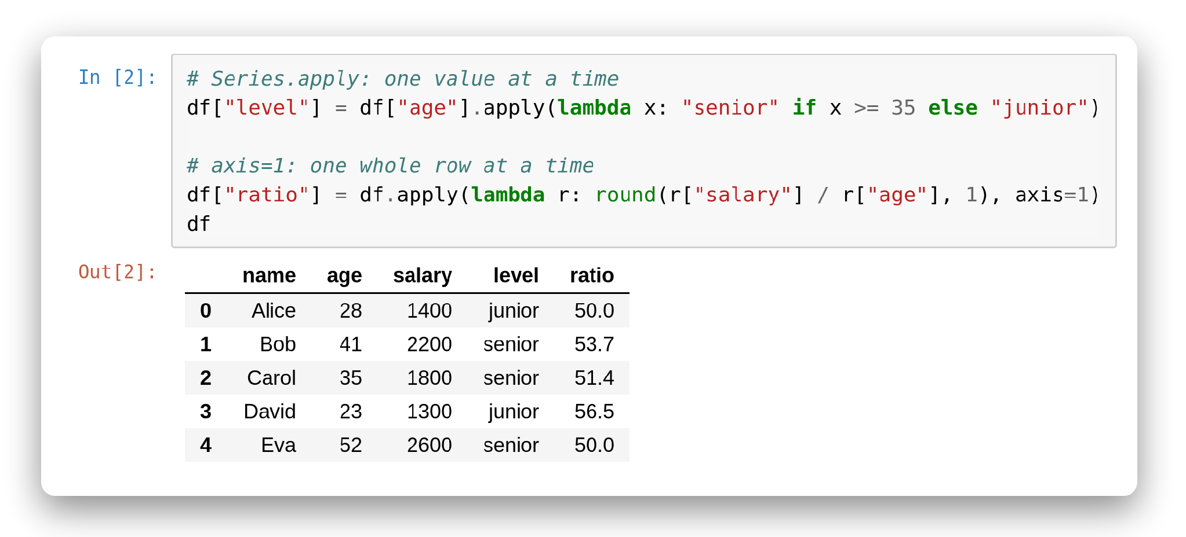
Apply & lambda
When built-ins aren't enough.
apply() runs a function on every value of a Series.
A lambda is a tiny inline function — great for a quick rule.
On a DataFrame, axis=1 applies the function row by row.
Notes:
# In [1]
import pandas as pd
df = pd.DataFrame({"name": ["Alice", "Bob", "Carol", "David", "Eva"],
"age": [28, 41, 35, 23, 52],
"salary": [1400, 2200, 1800, 1300, 2600]})
df
# In [2]
# Series.apply: one value at a time
df["level"] = df["age"].apply(lambda x: "senior" if x >= 35 else "junior")
# axis=1: one whole row at a time
df["ratio"] = df.apply(lambda r: round(r["salary"] / r["age"], 1), axis=1)
df

Slide 18
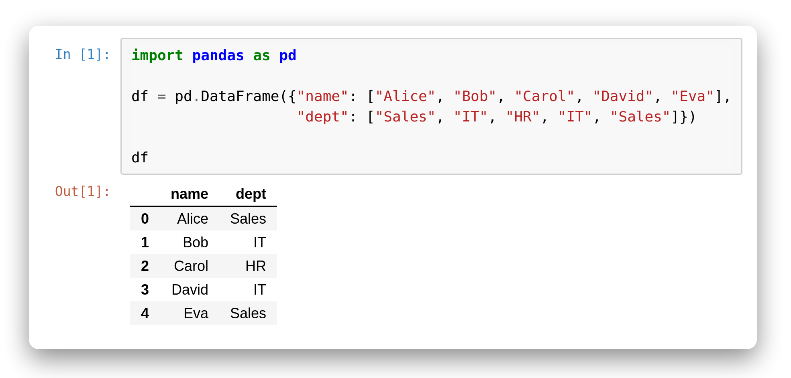
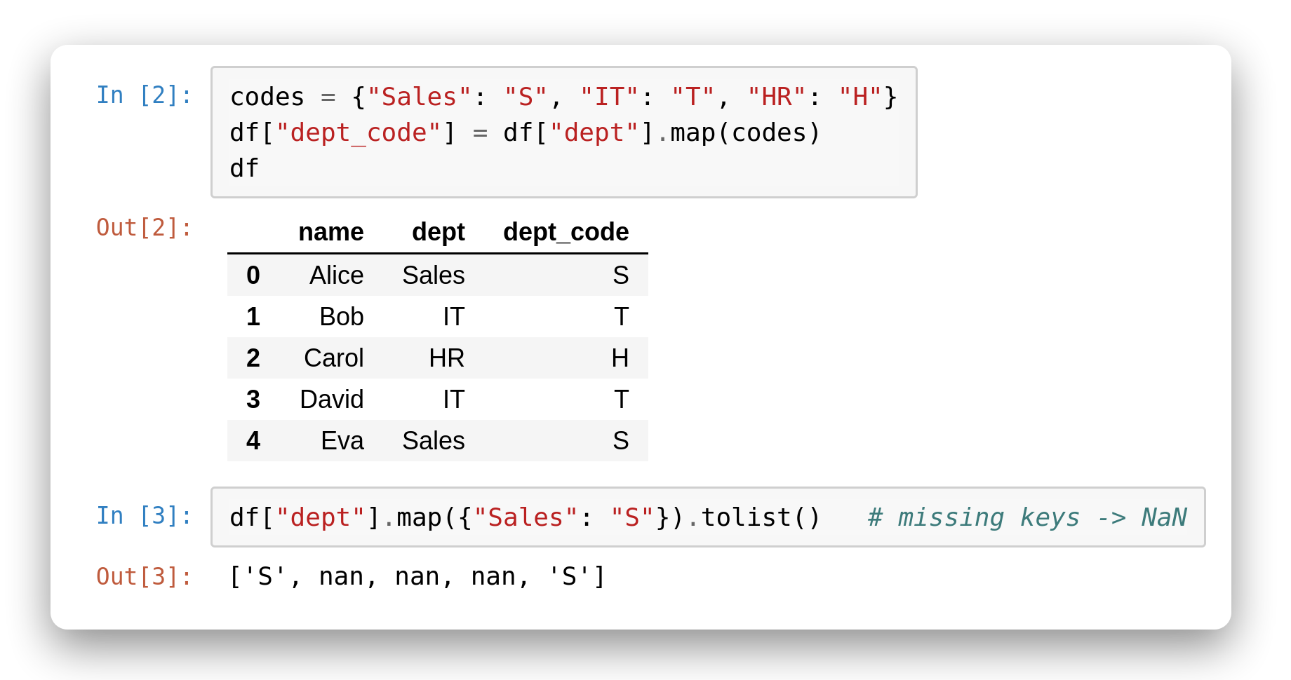
Swap values using a lookup (dict).
Using map with a dict
map() replaces each value using a dict of old to new.
Perfect for turning categories into short codes or labels.
Any value missing from the dict becomes NaN.
● Insight: use map for value-to-value swaps; reach for apply only when you need real logic.
Notes:
# In [1]
import pandas as pd
df = pd.DataFrame({"name": ["Alice", "Bob", "Carol", "David", "Eva"],
"dept": ["Sales", "IT", "HR", "IT", "Sales"]})
df
# In [2]
codes = {"Sales": "S", "IT": "T", "HR": "H"}
df["dept_code"] = df["dept"].map(codes)
df
# In [3]
df["dept"].map({"Sales": "S"}).tolist() # missing keys -> NaN

Slide 19
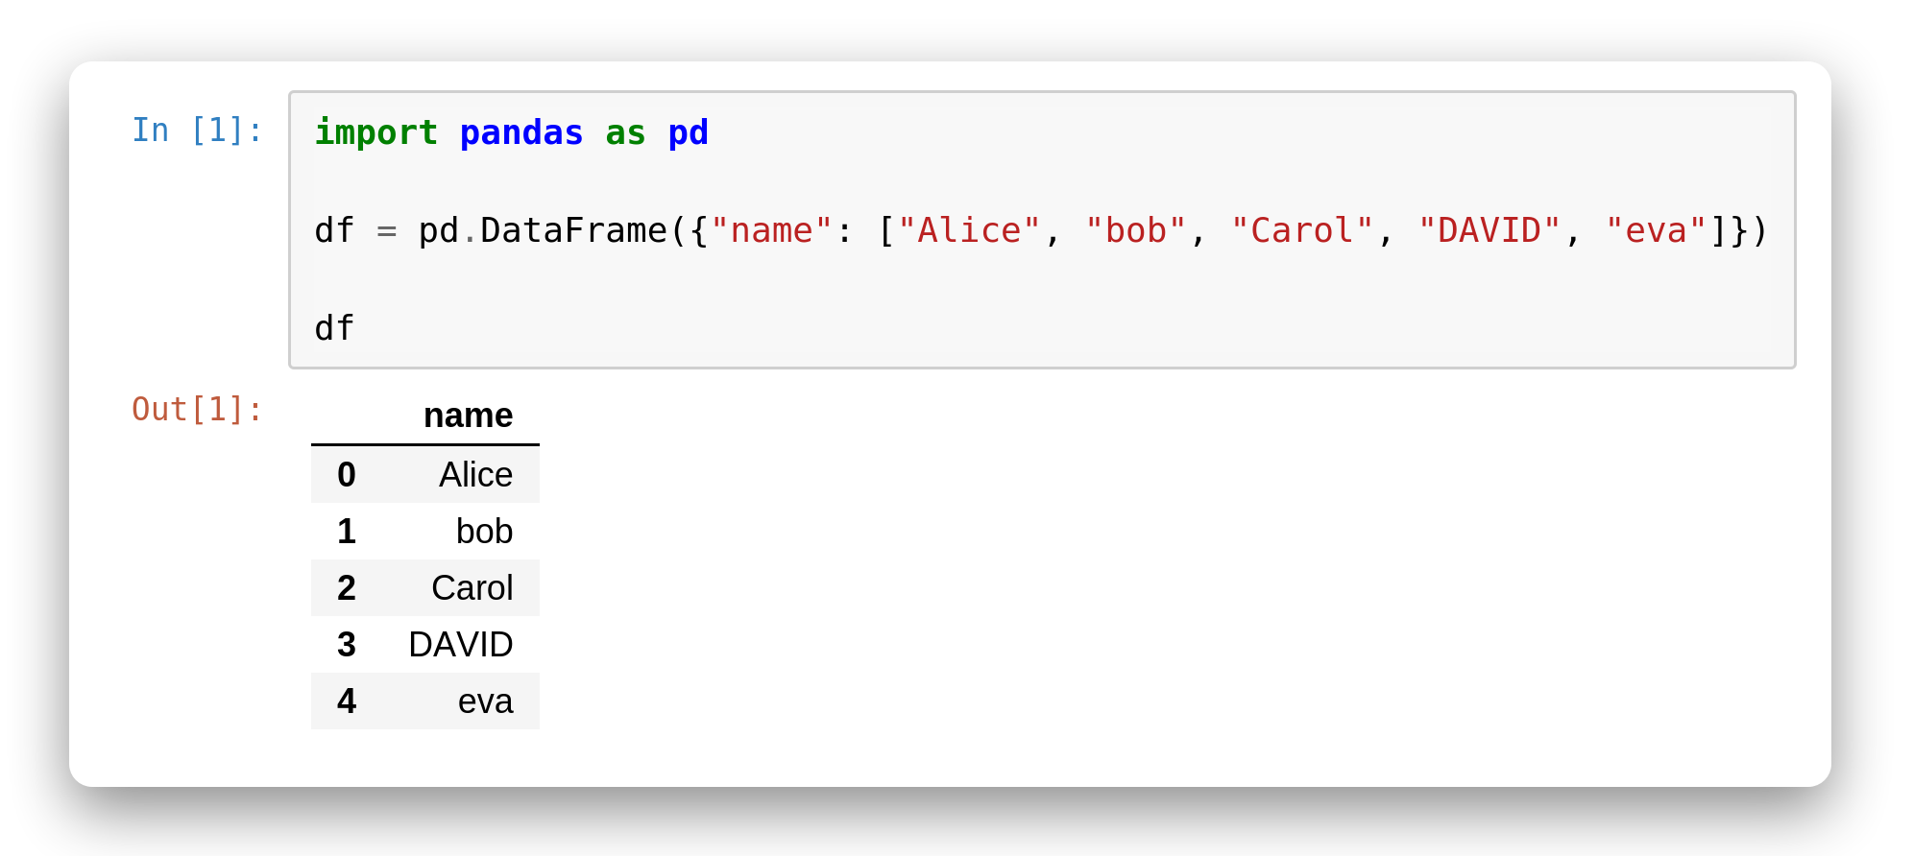
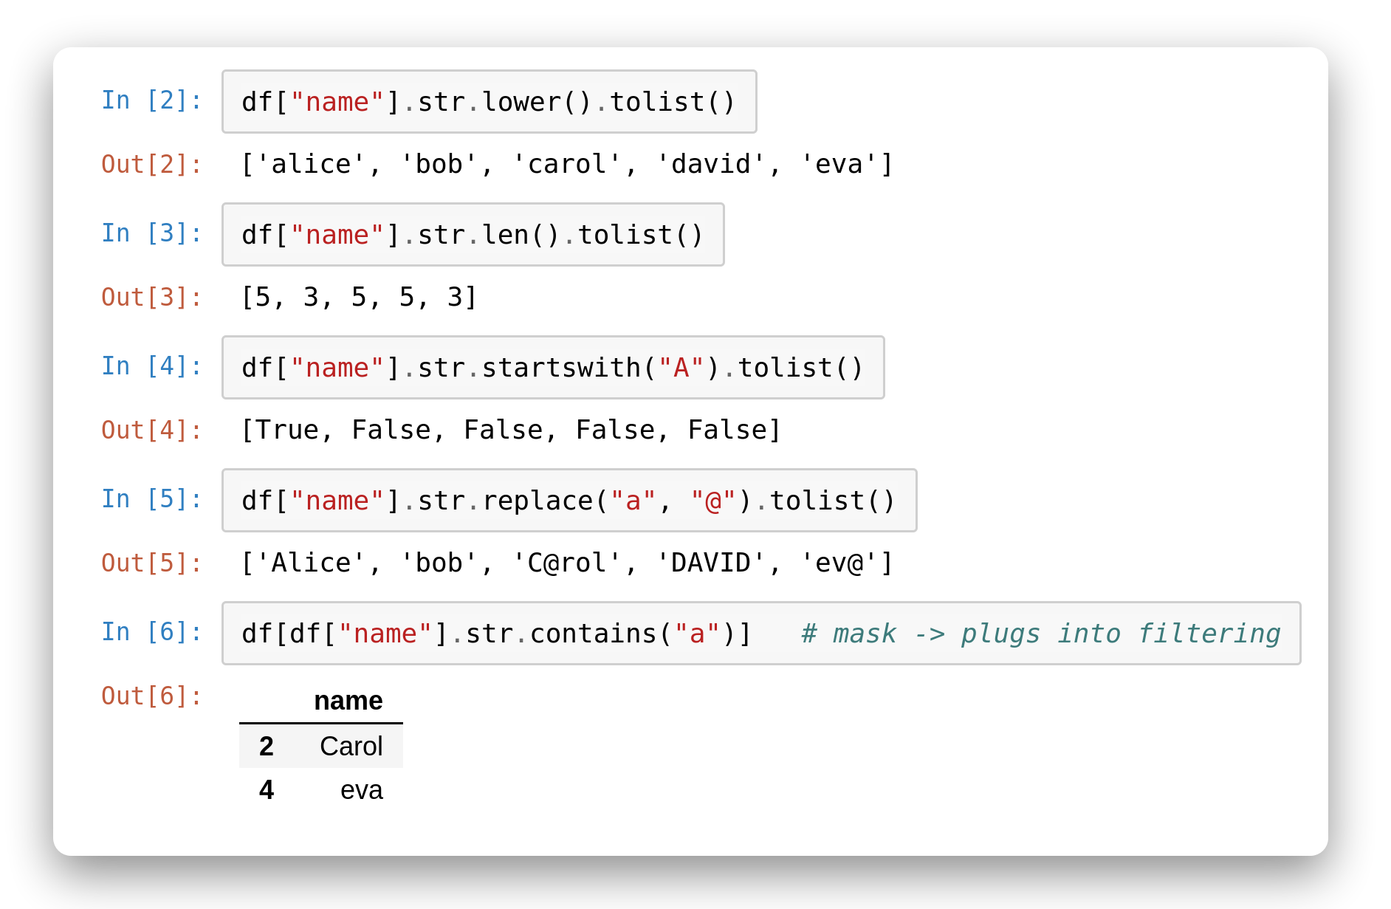
String Methods
The .str accessor
Prefix a text Series with .str to use string methods on every row.
lower(), len(), startswith(), replace() all work element-wise.
contains() returns a mask — so it plugs straight into filtering.
Notes:
# In [1]
import pandas as pd
df = pd.DataFrame({"name": ["Alice", "bob", "Carol", "DAVID", "eva"]})
df
# In [2]
df["name"].str.lower().tolist()
# In [3]
df["name"].str.len().tolist()
# In [4]
df["name"].str.startswith("A").tolist()
# In [5]
df["name"].str.replace("a", "@").tolist()
# In [6]
df[df["name"].str.contains("a")] # mask -> plugs into filtering

Slide 20
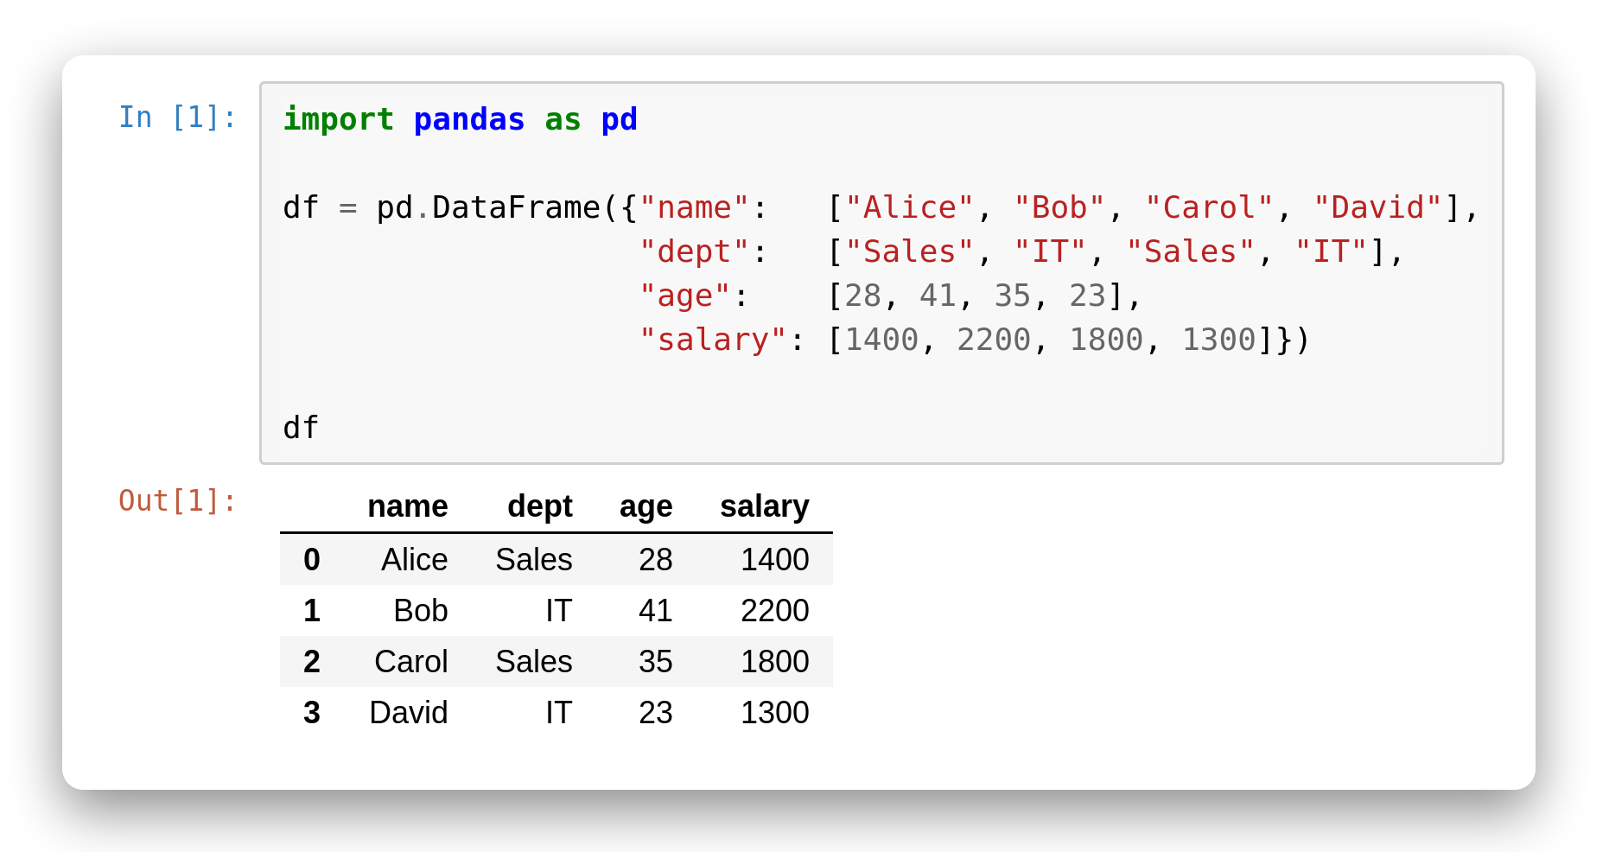
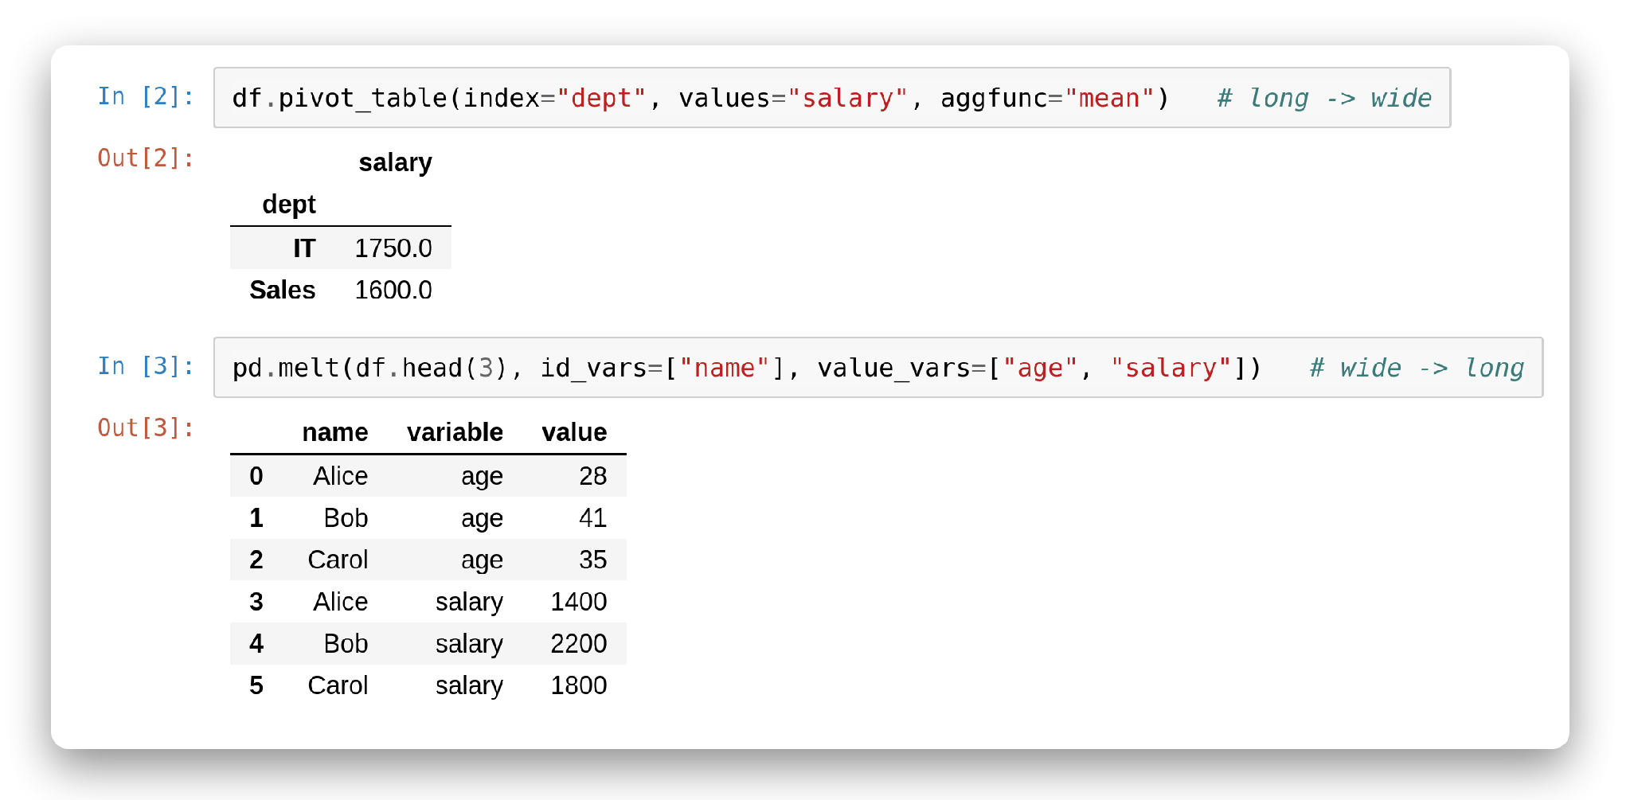
Pivot & melt
Wide and long
pivot_table: one summary number per group.
melt: many columns collapse into rows.
Notes:
# In [1]
import pandas as pd
df = pd.DataFrame({"name": ["Alice", "Bob", "Carol", "David"],
"dept": ["Sales", "IT", "Sales", "IT"],
"age": [28, 41, 35, 23],
"salary": [1400, 2200, 1800, 1300]})
df
# In [2]
df.pivot_table(index="dept", values="salary", aggfunc="mean") # long -> wide
# In [3]
pd.melt(df.head(3), id_vars=["name"], value_vars=["age", "salary"]) # wide -> long

Slide 21
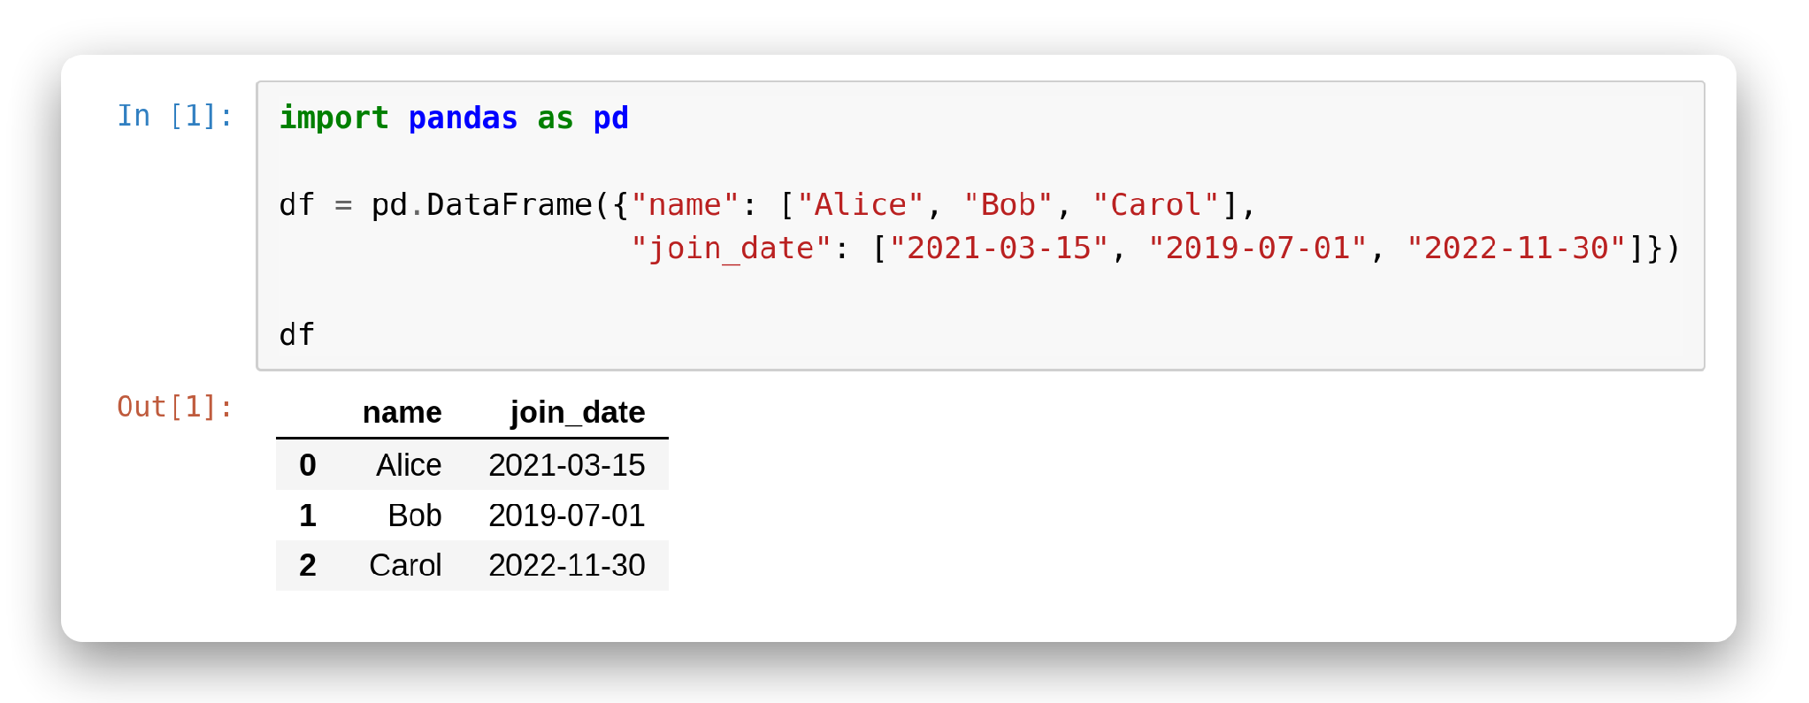
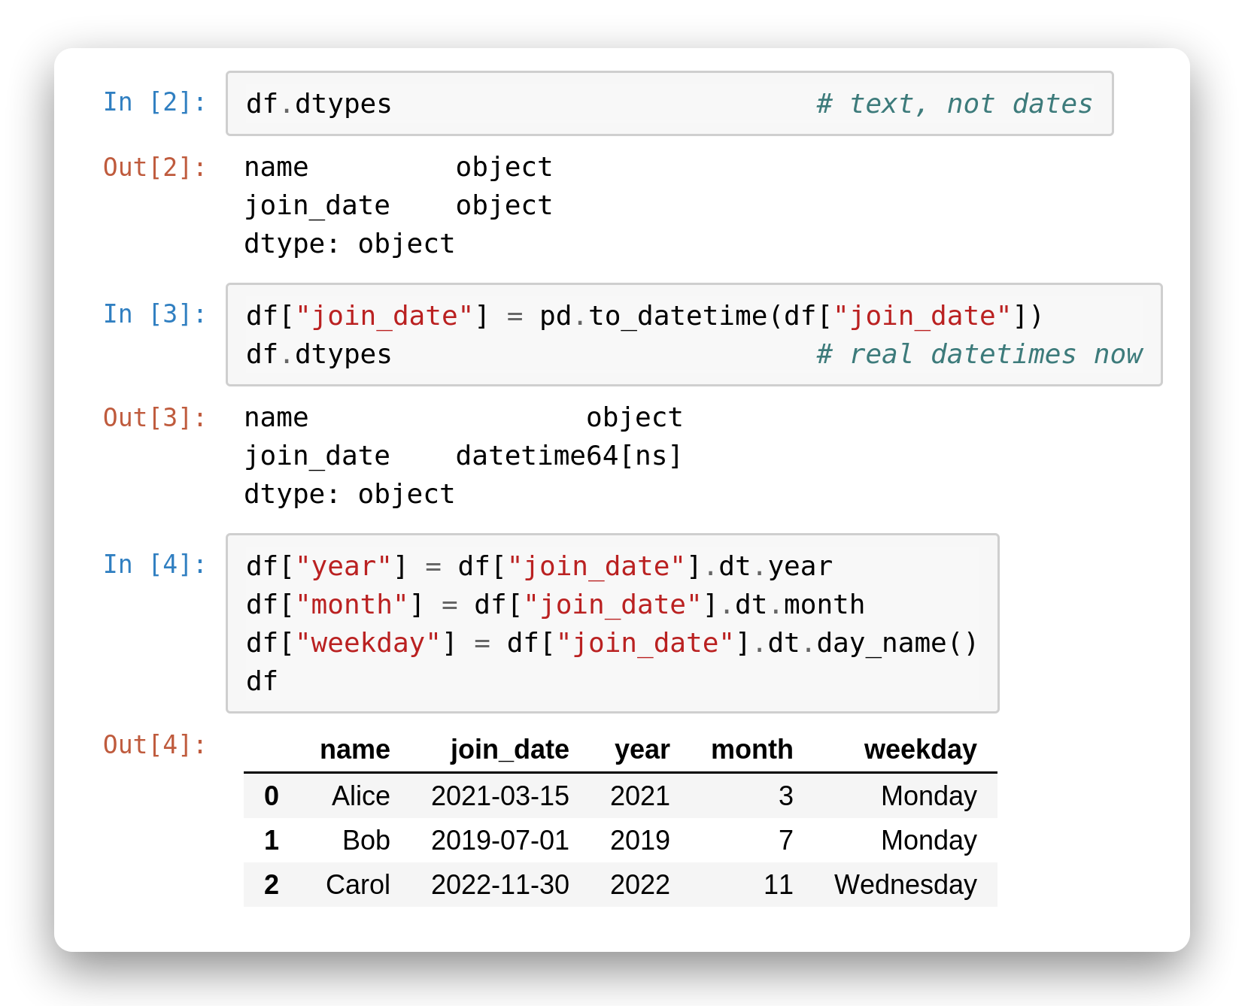
Parse Dates
Text into real dates
Strings can't do date math.
pd.to_datetime() converts a text column into real datetimes.
Then the .dt accessor unlocks year, month, day_name(), and more.
Do this once, up front — everything downstream gets easier.
Notes:
# In [1]
import pandas as pd
df = pd.DataFrame({"name": ["Alice", "Bob", "Carol"],
"join_date": ["2021-03-15", "2019-07-01", "2022-11-30"]})
df
# In [2]
df.dtypes # text, not dates
# In [3]
df["join_date"] = pd.to_datetime(df["join_date"])
df.dtypes # real datetimes now
# In [4]
df["year"] = df["join_date"].dt.year
df["month"] = df["join_date"].dt.month
df["weekday"] = df["join_date"].dt.day_name()
df

Slide 22
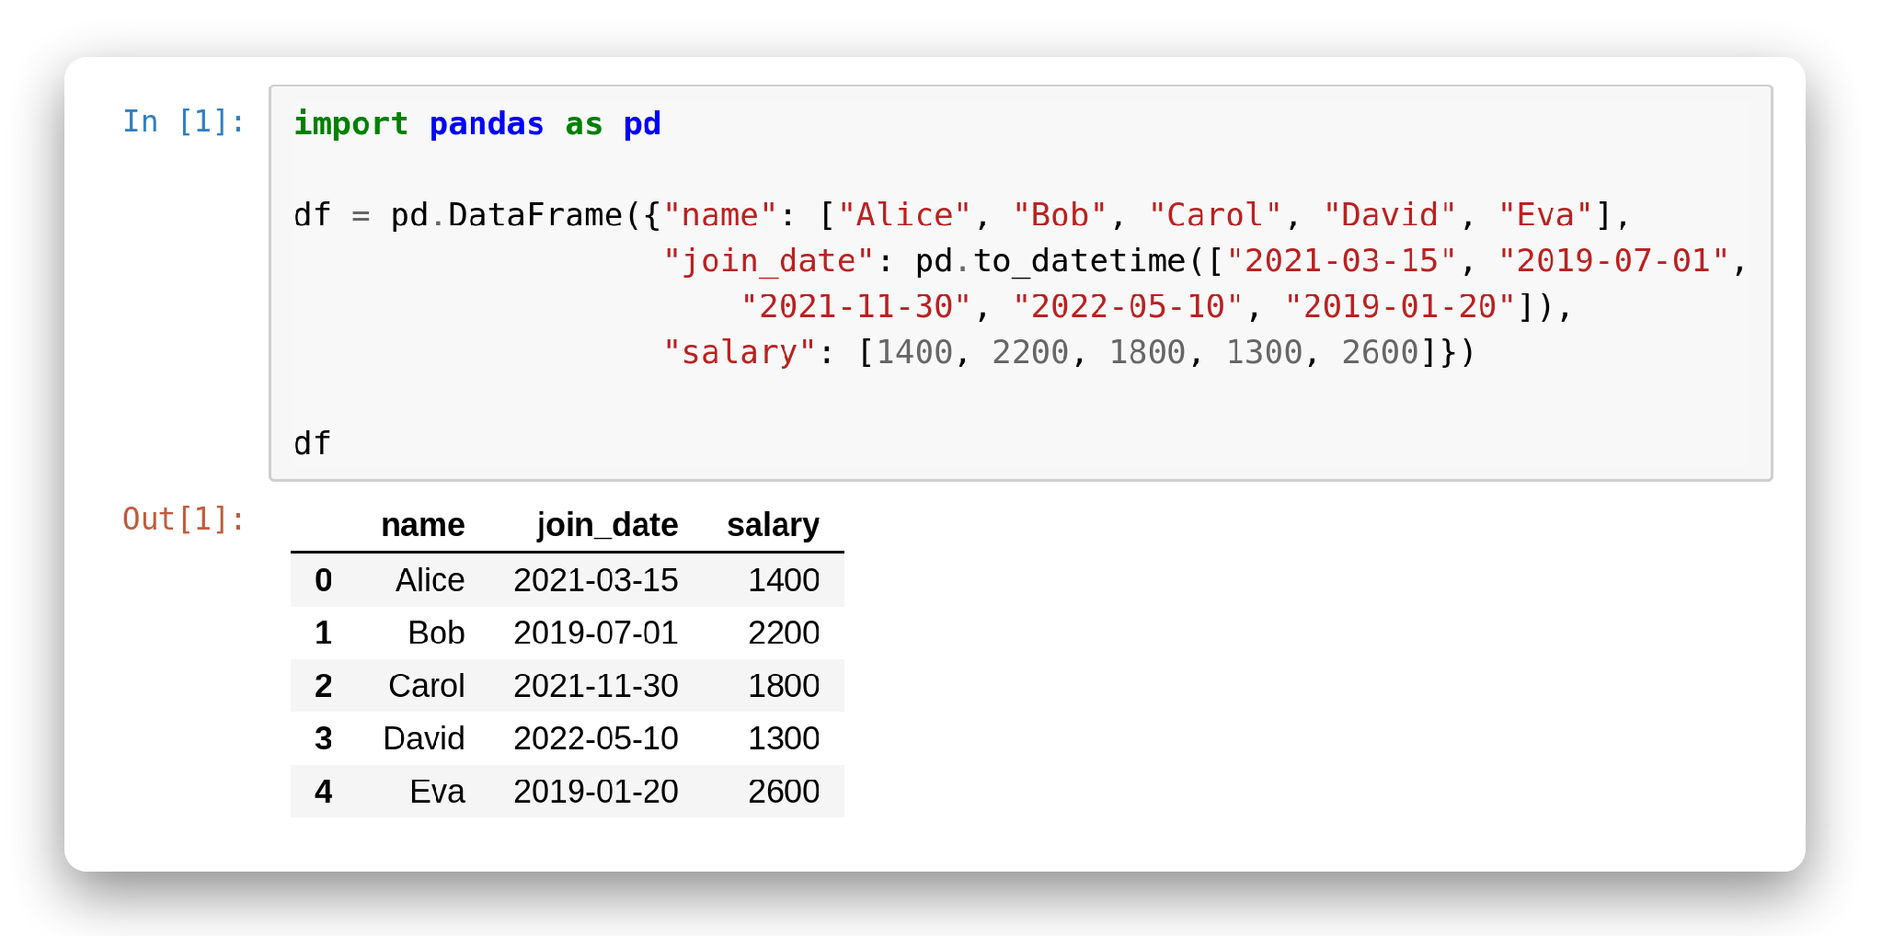
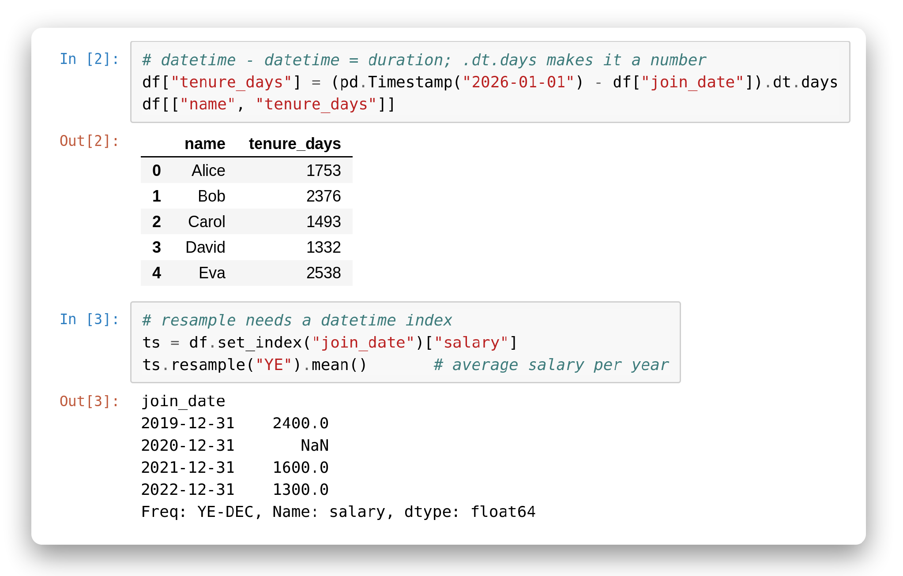
Date Math & Resample
Math with time
Subtracting two datetimes gives a duration; .dt.days turns it into a number.
resample() groups a datetime-indexed series into time buckets.
"YE" = year-end, "ME" = month-end, "W" = weekly.
● Insight: resample only works when the index is a datetime — that's what set_index is for here.
Notes:
# In [1]
import pandas as pd
df = pd.DataFrame({"name": ["Alice", "Bob", "Carol", "David", "Eva"],
"join_date": pd.to_datetime(["2021-03-15", "2019-07-01",
"2021-11-30", "2022-05-10", "2019-01-20"]),
"salary": [1400, 2200, 1800, 1300, 2600]})
df
# In [2]
# datetime - datetime = duration; .dt.days makes it a number
df["tenure_days"] = (pd.Timestamp("2026-01-01") - df["join_date"]).dt.days
df[["name", "tenure_days"]]
# In [3]
# resample needs a datetime index
ts = df.set_index("join_date")["salary"]
ts.resample("YE").mean() # average salary per year

Slide 23
Missing Value

Slide 24
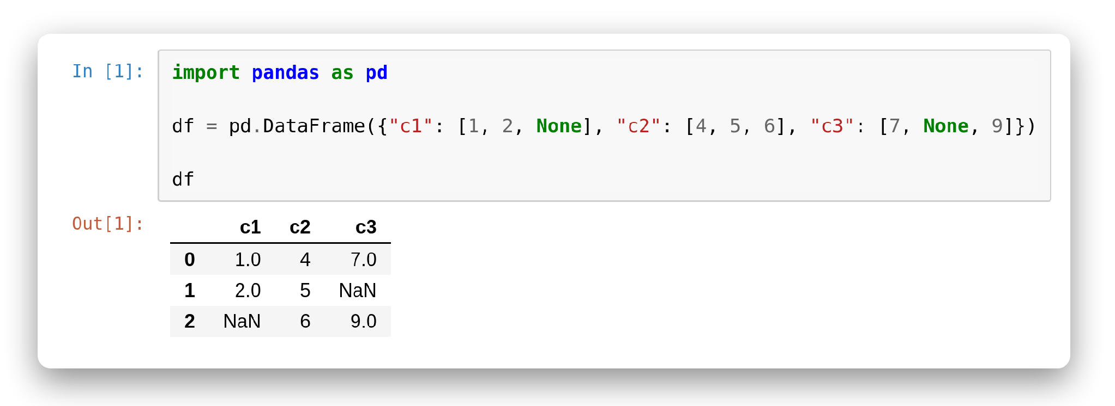
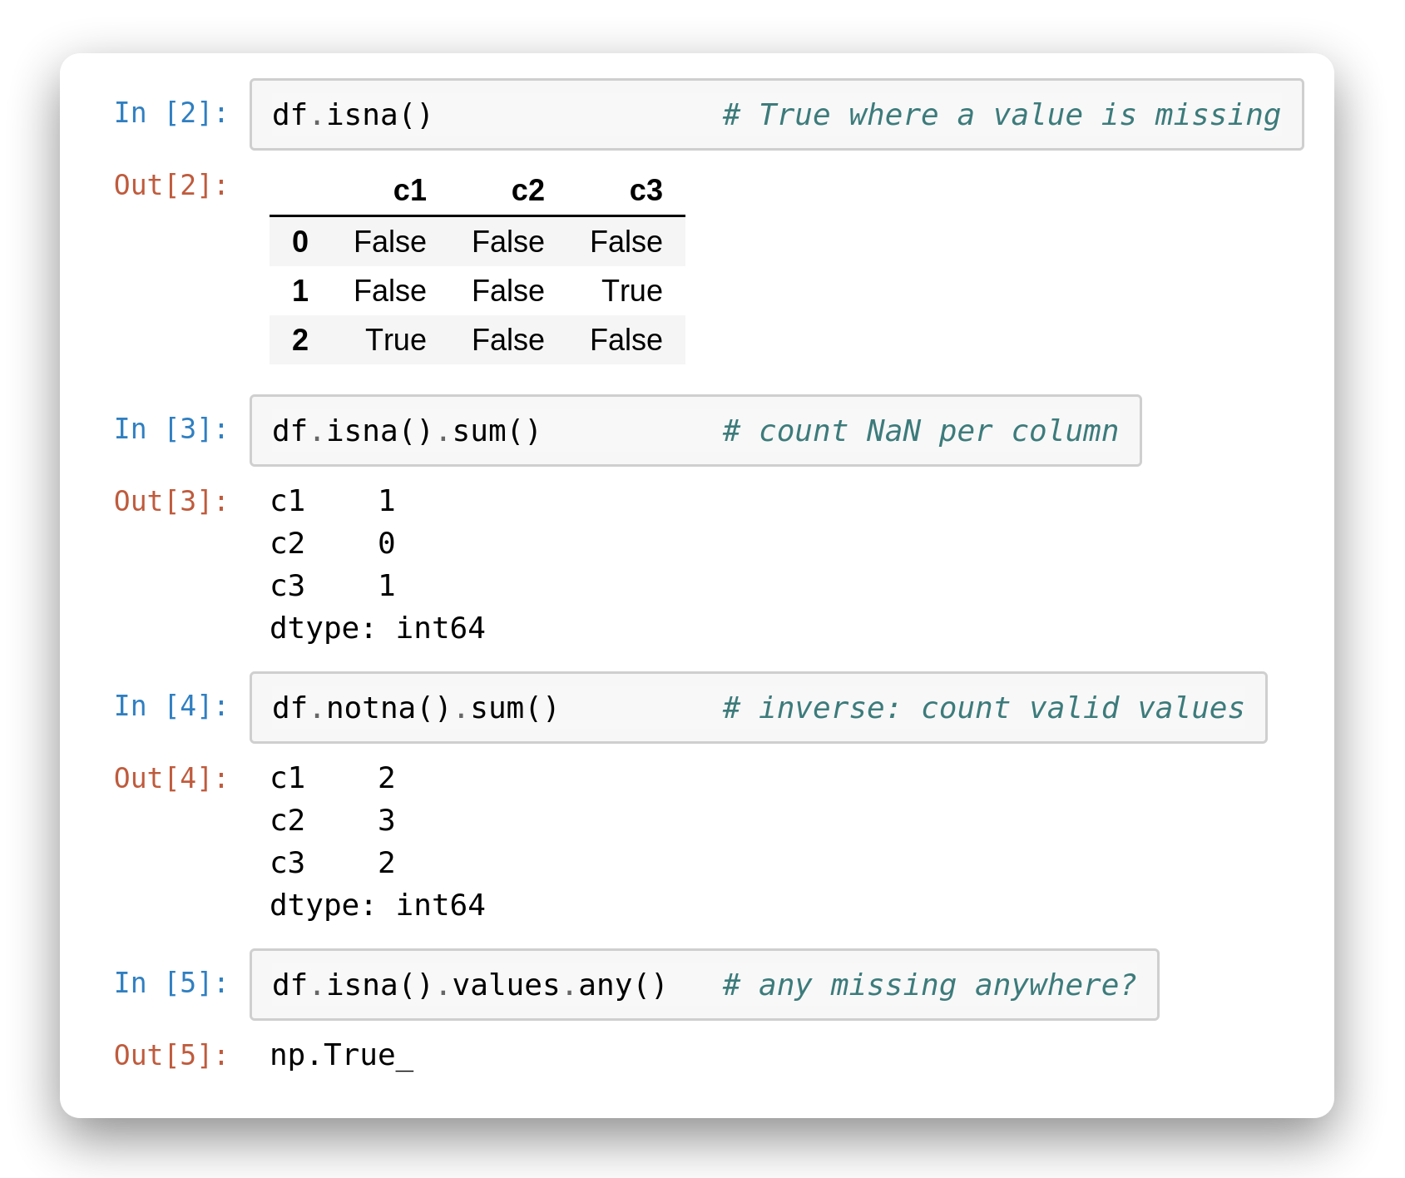
Detect Missing
NaN awareness
.isna() returns a boolean mask of missing cells.
.isna().sum() counts gaps per column.
.notna() is the inverse.
Spot problems before you analyze.
Notes:
# In [1]
import pandas as pd
df = pd.DataFrame({"c1": [1, 2, None], "c2": [4, 5, 6], "c3": [7, None, 9]})
df
# In [2]
df.isna() # True where a value is missing
# In [3]
df.isna().sum() # count NaN per column
# In [4]
df.notna().sum() # inverse: count valid values
# In [5]
df.isna().values.any() # any missing anywhere?

Slide 25
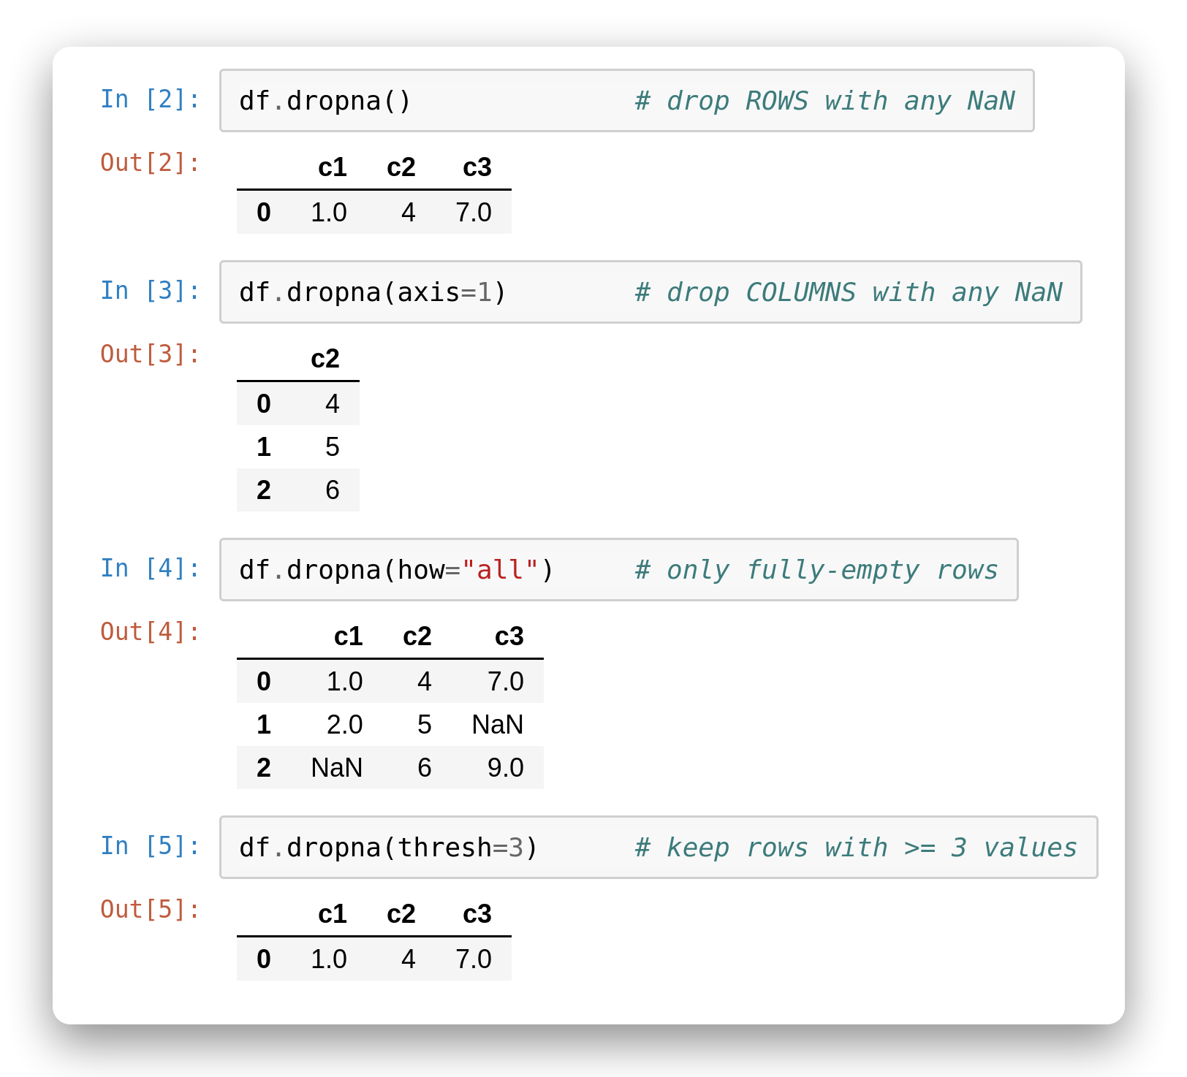
Drop Missing
dropna by row or column
.dropna() removes any row with a NaN.
axis=1 drops offending columns instead.
how='all' only drops fully-empty rows.
thresh=n keeps rows with n non-null values.
Notes:
# In [1]
import pandas as pd
df = pd.DataFrame({"c1": [1, 2, None], "c2": [4, 5, 6], "c3": [7, None, 9]})
df
# In [2]
df.dropna() # drop ROWS with any NaN
# In [3]
df.dropna(axis=1) # drop COLUMNS with any NaN
# In [4]
df.dropna(how="all") # only fully-empty rows
# In [5]
df.dropna(thresh=3) # keep rows with >= 3 values

Slide 26
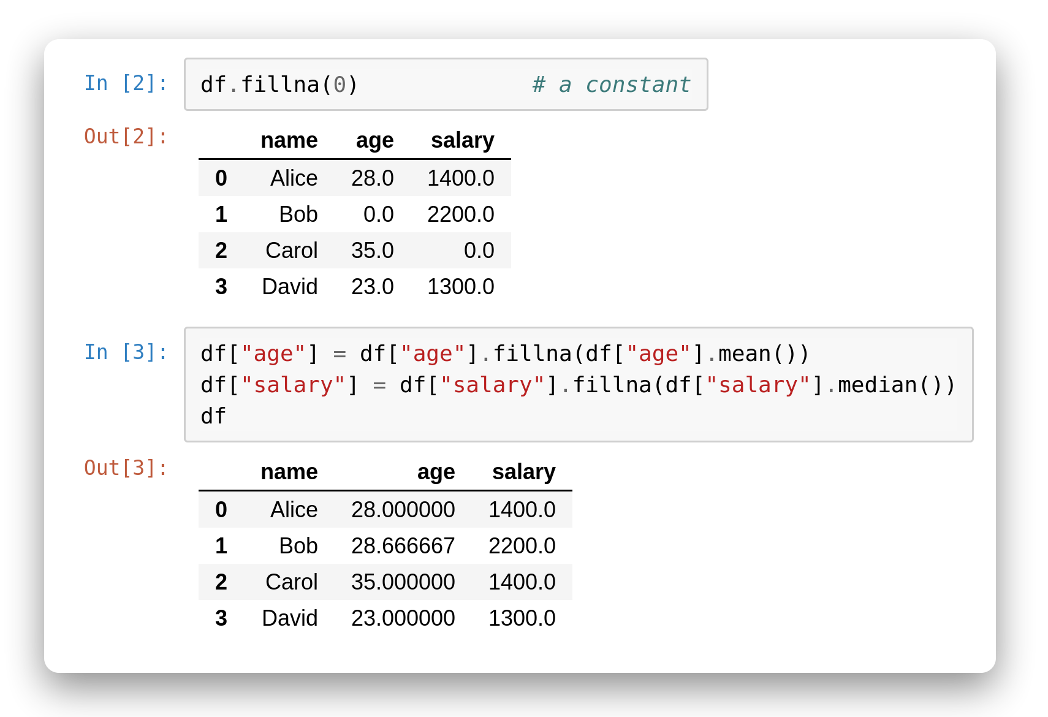
Fill Missing
fillna with a value
.fillna(0) replaces gaps with a constant.
We may fill a column with its own mean or median to keeps the row count intact.
Choose the fill that fits the data's meaning.
Insight: the mean is common, but the median is safer when a column has outliers.
Notes:
# In [1]
import pandas as pd
df = pd.DataFrame({"name": ["Alice", "Bob", "Carol", "David"],
"age": [28, None, 35, 23],
"salary": [1400, 2200, None, 1300]})
df
# In [2]
df.fillna(0) # a constant
# In [3]
df["age"] = df["age"].fillna(df["age"].mean())
df["salary"] = df["salary"].fillna(df["salary"].median())
df

Slide 27
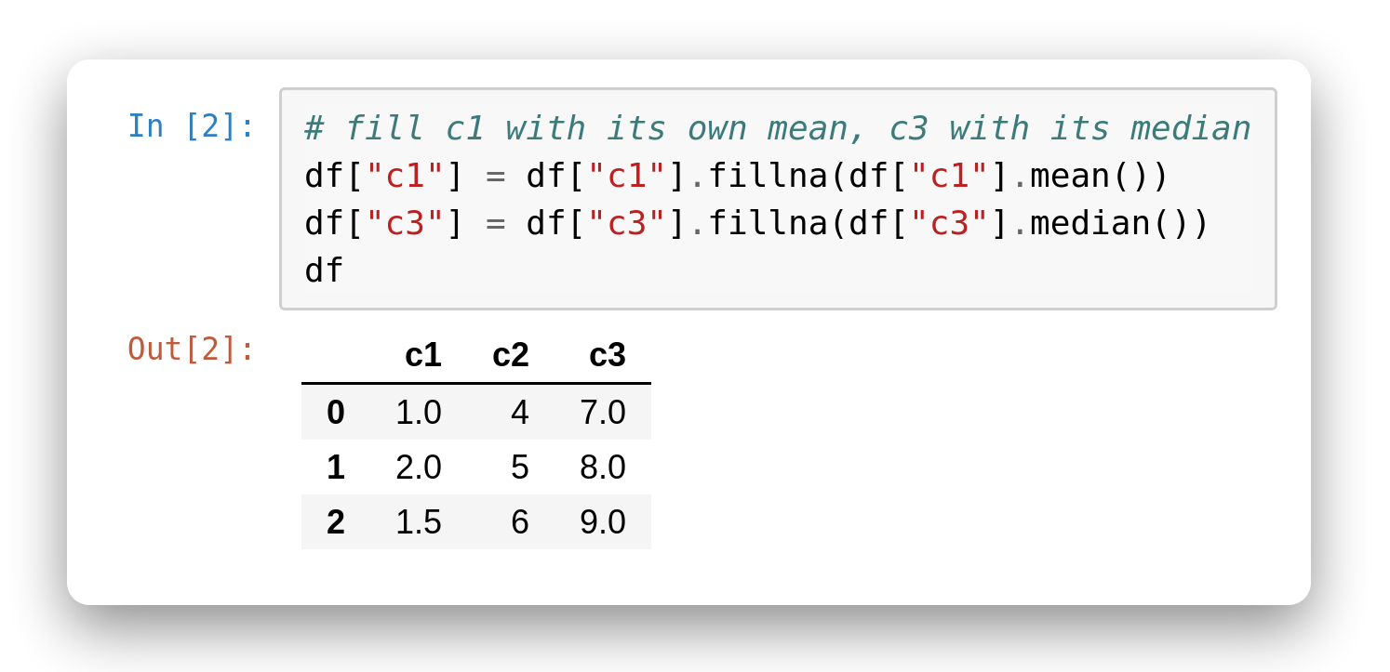
Fill by Aggregation
Use the column's own statistic
Compute the statistic first, then hand it to fillna().
Assign the result back with df[col] = ....
Each column can use a different rule.
Notes:
# In [1]
import pandas as pd
df = pd.DataFrame({"c1": [1, 2, None], "c2": [4, 5, 6], "c3": [7, None, 9]})
df
# In [2]
# fill c1 with its own mean, c3 with its median
df["c1"] = df["c1"].fillna(df["c1"].mean())
df["c3"] = df["c3"].fillna(df["c3"].median())
df

Slide 28
Aggregation
17

Slide 29
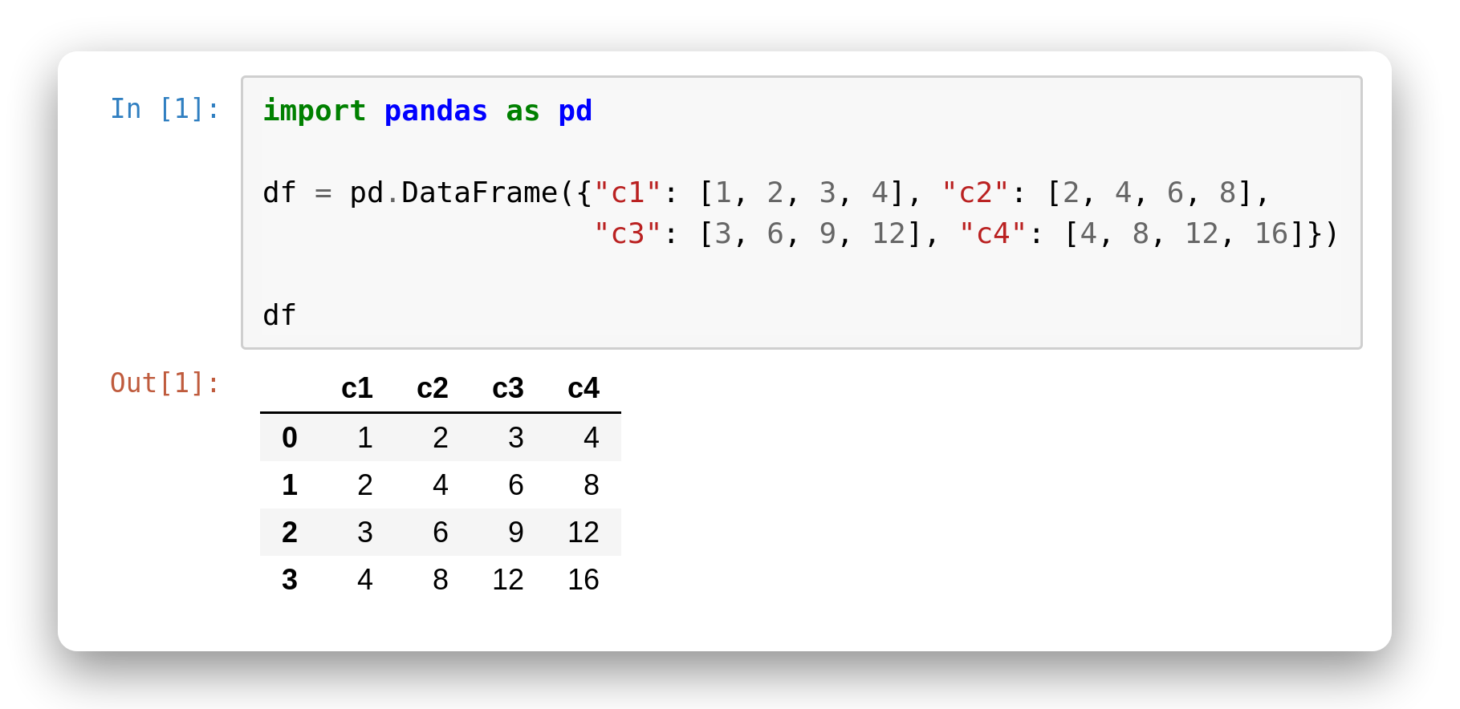
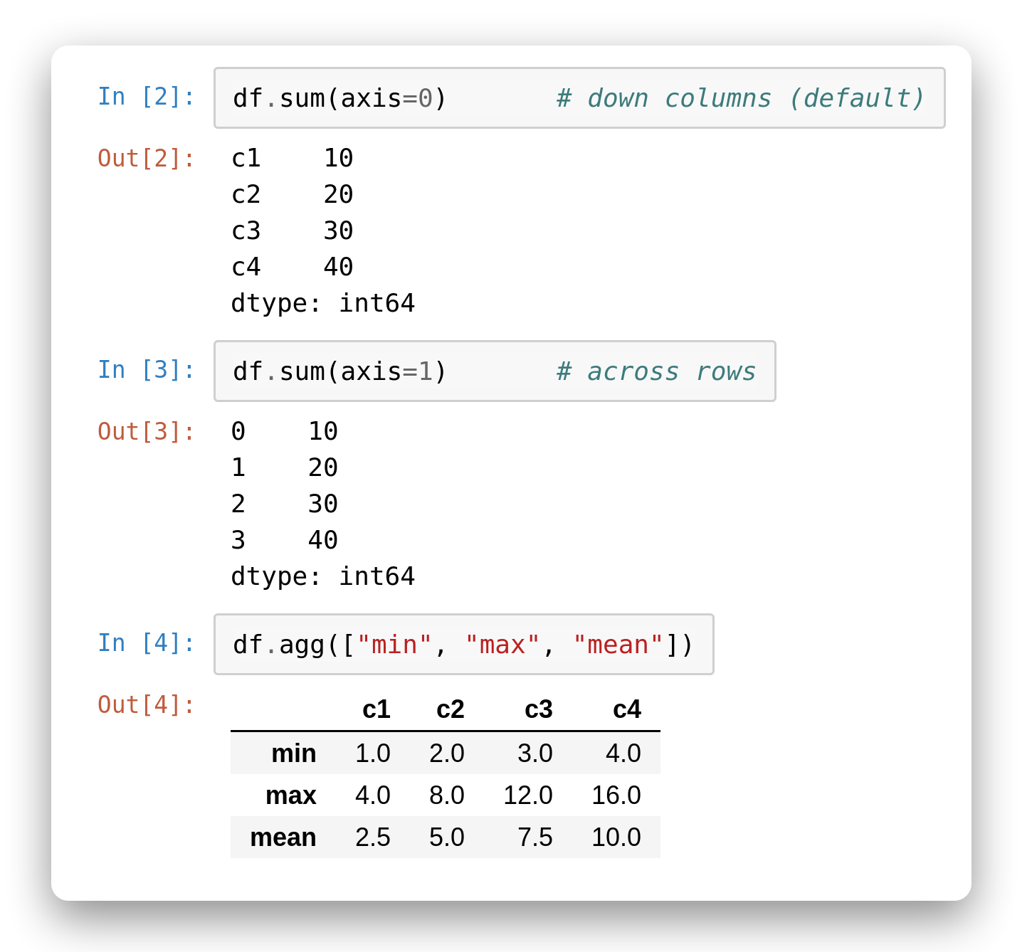
Aggregate a DataFrame
By row or column
axis=0 aggregates down columns (the default).
axis=1 aggregates across rows.
.agg([...]) runs several functions at once.
Notes:
# In [1]
import pandas as pd
df = pd.DataFrame({"c1": [1, 2, 3, 4], "c2": [2, 4, 6, 8],
"c3": [3, 6, 9, 12], "c4": [4, 8, 12, 16]})
df
# In [2]
df.sum(axis=0) # down columns (default)
# In [3]
df.sum(axis=1) # across rows
# In [4]
df.agg(["min", "max", "mean"])

Slide 30
Group By
The groupby method is to group rows of data together and call aggregate functions

Slide 31
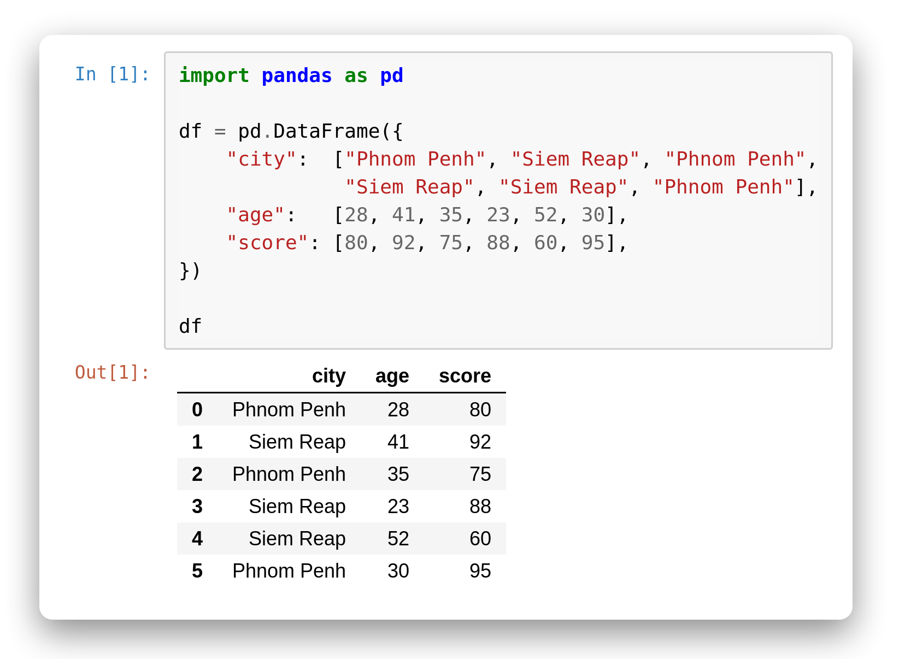
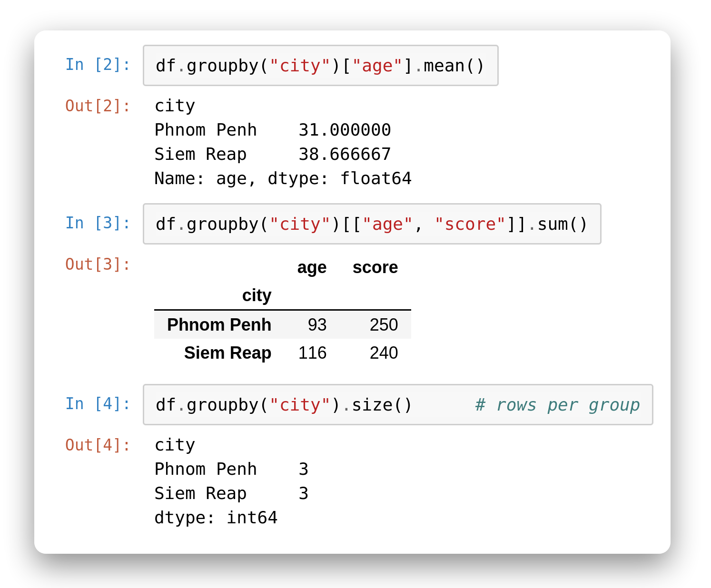
groupby()
Split, apply, combine
df.groupby('col') splits rows into groups.
Chain an aggregate: .mean() / .sum() / .size().
The grouping column becomes the new index.
One line replaces a manual loop over categories.
Notes:
# In [1]
import pandas as pd
df = pd.DataFrame({
"city": ["Phnom Penh", "Siem Reap", "Phnom Penh",
"Siem Reap", "Siem Reap", "Phnom Penh"],
"age": [28, 41, 35, 23, 52, 30],
"score": [80, 92, 75, 88, 60, 95],
})
df
# In [2]
df.groupby("city")["age"].mean()
# In [3]
df.groupby("city")[["age", "score"]].sum()
# In [4]
df.groupby("city").size() # rows per group

Slide 32
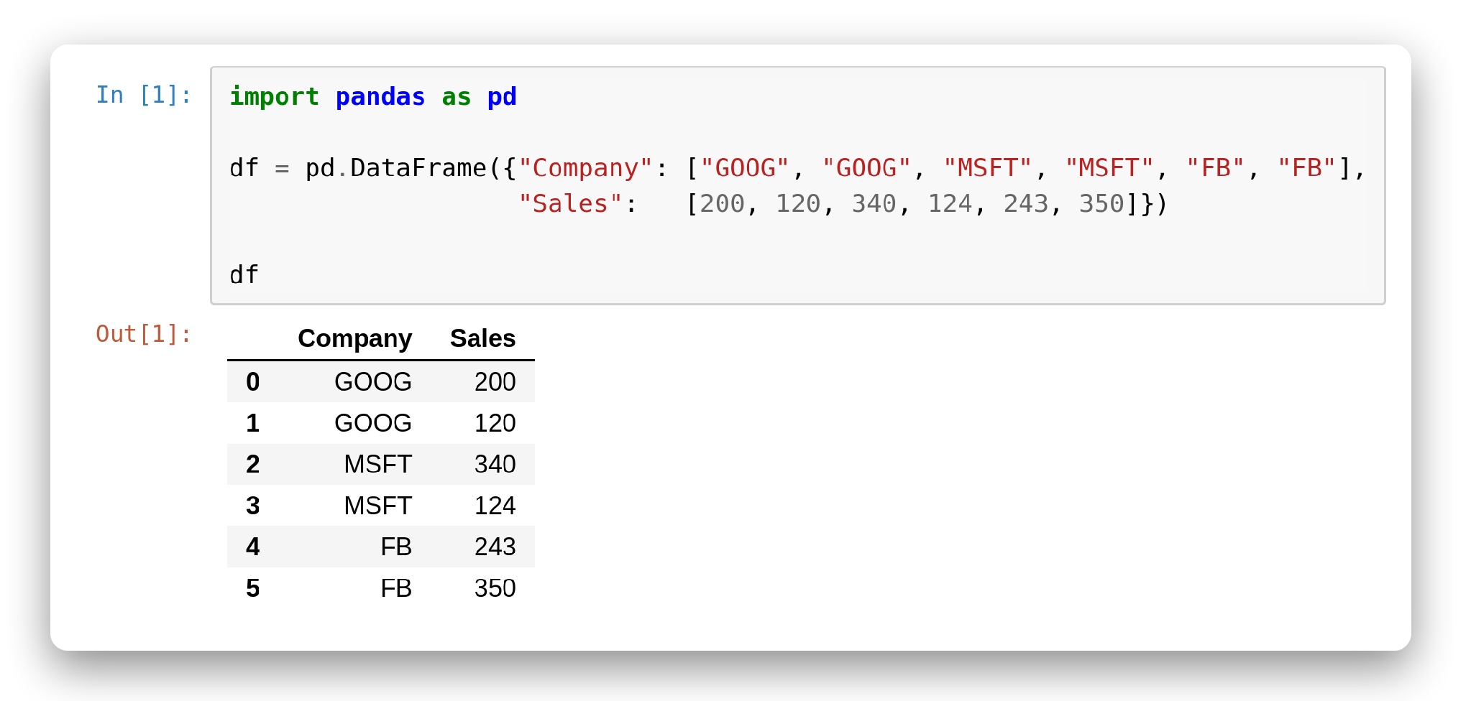
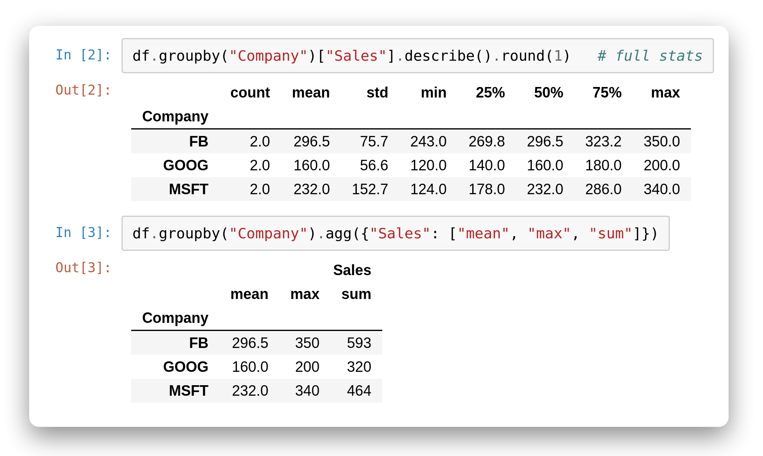
Describe by Group
Richer summaries
.describe() gives full stats per group.
.agg({...}) applies different functions per column.
Combine several metrics in one call.
Great for comparing categories side by side.
Notes:
# In [1]
import pandas as pd
df = pd.DataFrame({"Company": ["GOOG", "GOOG", "MSFT", "MSFT", "FB", "FB"],
"Sales": [200, 120, 340, 124, 243, 350]})
df
# In [2]
df.groupby("Company")["Sales"].describe().round(1) # full stats
# In [3]
df.groupby("Company").agg({"Sales": ["mean", "max", "sum"]})

Slide 33
Combine multiple data into one

Slide 34
Three Ways to Combine
OVERVIEW
Concatenate
Glue frames together along an axis — stack rows or columns. Dimensions must match.
Merge
Combine on a key column, exactly like a SQL join.
Join
Combine on the index of two differently-indexed frames.

Slide 35
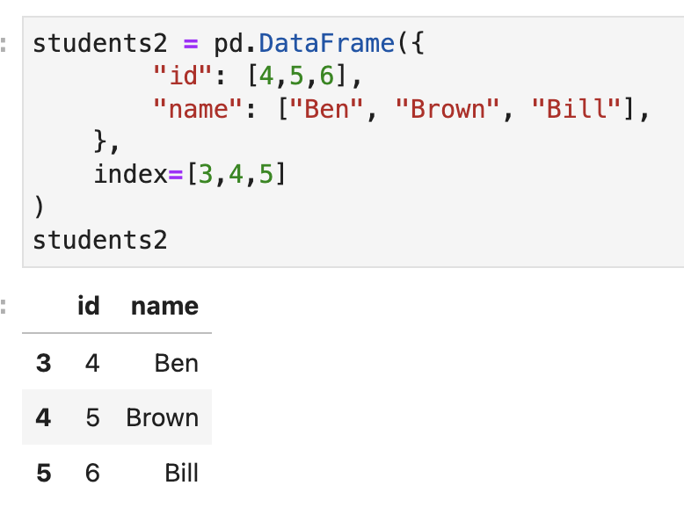
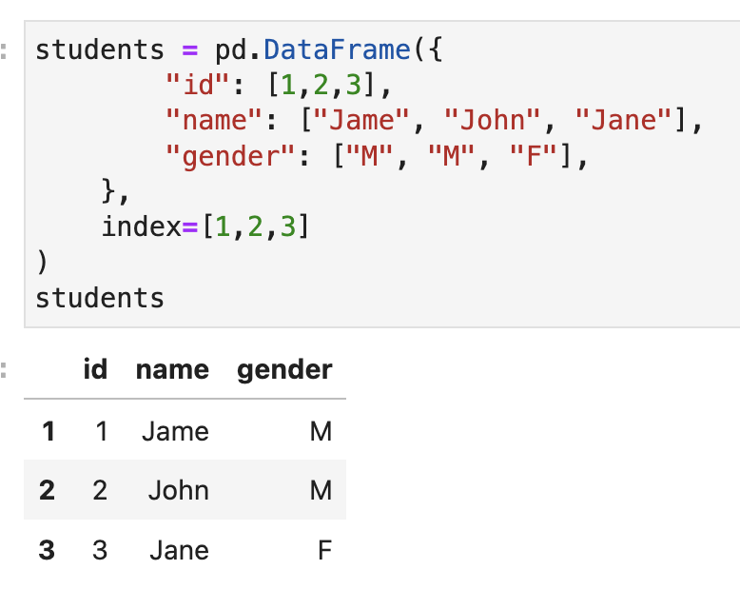
Concatenate
Concatenation basically glues together DataFrames. Keep in mind that dimensions should match along the axis you are concatenating on. You can use pd.concat and pass in a list of DataFrames to concatenate together:

Slide 36
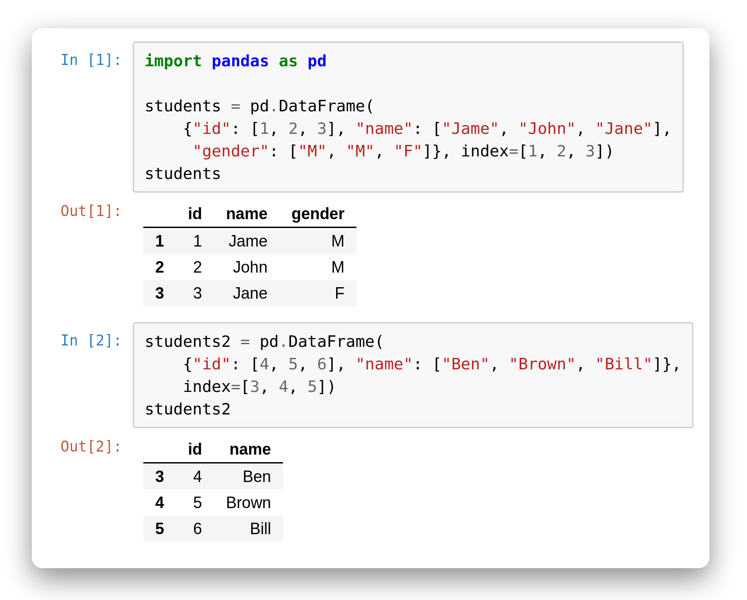
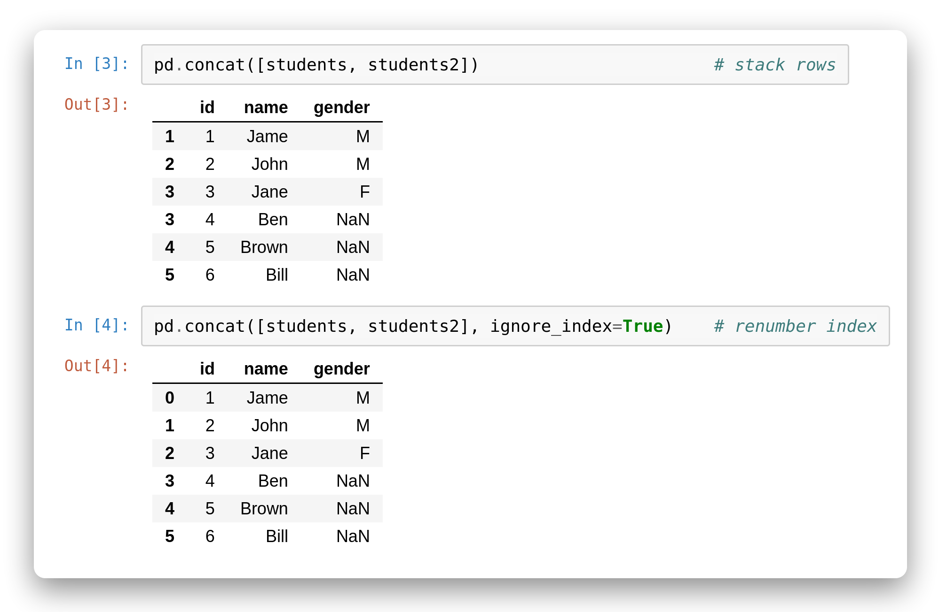
Concatenate Rows
Glue frames together
pd.concat([...]) stacks a list of frames.
Vertical (axis=0) adds rows — columns that don't match become NaN.
ignore_index=True renumbers the rows after stacking.
Notes:
# In [1]
import pandas as pd
students = pd.DataFrame(
{"id": [1, 2, 3], "name": ["Jame", "John", "Jane"],
"gender": ["M", "M", "F"]}, index=[1, 2, 3])
students
# In [2]
students2 = pd.DataFrame(
{"id": [4, 5, 6], "name": ["Ben", "Brown", "Bill"]},
index=[3, 4, 5])
students2
# In [3]
pd.concat([students, students2]) # stack rows
# In [4]
pd.concat([students, students2], ignore_index=True) # renumber index

Slide 37
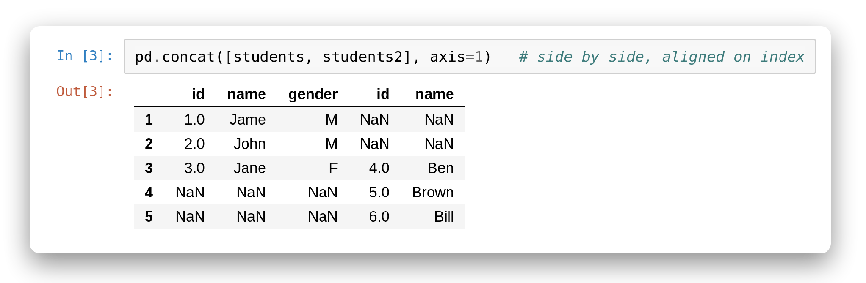
Concatenate Columns
Side by side
Horizontal (axis=1) adds columns, aligned on the index.
Rows with no partner get NaN.
Check your index first — misaligned indexes make gaps.
Notes:
# In [1]
import pandas as pd
students = pd.DataFrame(
{"id": [1, 2, 3], "name": ["Jame", "John", "Jane"],
"gender": ["M", "M", "F"]}, index=[1, 2, 3])
students
# In [2]
students2 = pd.DataFrame(
{"id": [4, 5, 6], "name": ["Ben", "Brown", "Bill"]},
index=[3, 4, 5])
students2
# In [3]
pd.concat([students, students2], axis=1) # side by side, aligned on index

Slide 38
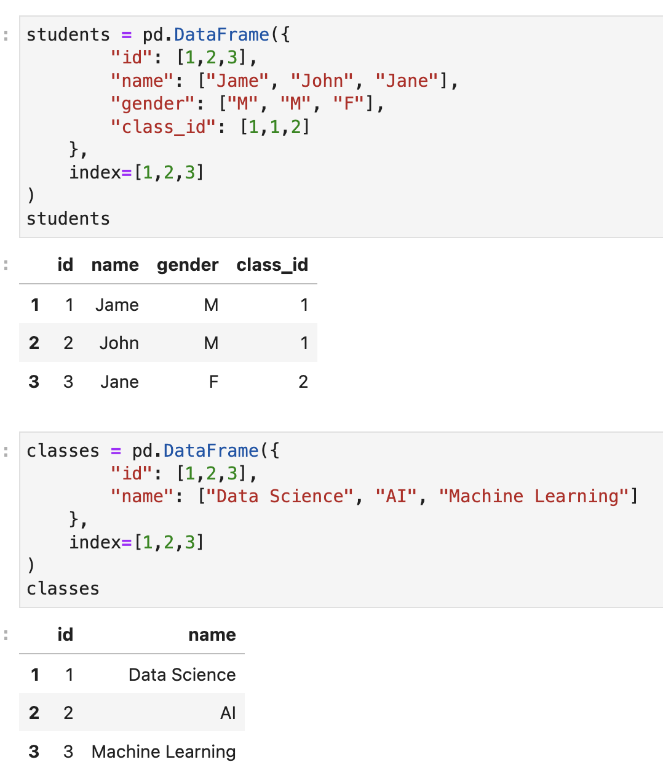
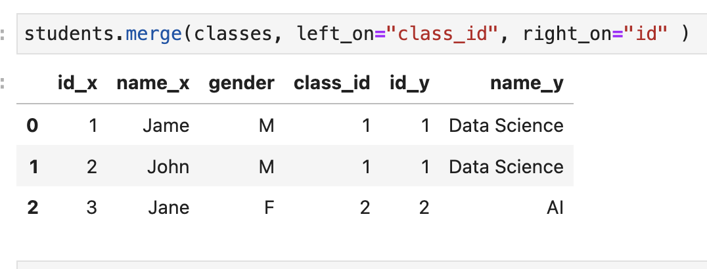
Merge
The merge function allows you to merge DataFrames together using a similar logic as merging SQL Tables together. For example

Slide 39


Merge
SQL-style on a key
pd.merge(l, r, on='id') joins on a shared column.
how= picks the join type: inner, left, right, outer.
left_on / right_on when key names differ.
Same-named columns get _x / _y suffixes.
Notes:
# In [1]
import pandas as pd
students = pd.DataFrame({"id": [1, 2, 3], "name": ["Jame", "John", "Jane"],
"class_id": [1, 1, 2]})
students
# In [2]
classes = pd.DataFrame({"id": [1, 2, 3],
"name": ["Data Science", "AI", "Machine Learning"]})
classes
# In [3]
# key names differ -> left_on / right_on
students.merge(classes, left_on="class_id", right_on="id")
# In [4]
# how= picks the join type (class 3 has no students)
students.merge(classes, how="right", left_on="class_id", right_on="id")

Slide 40

Join
Combine on the index
left.join(right) aligns on the row index.
Convenient when frames are indexed the same way.
how= controls which keys survive.
Under the hood it's merge on the index.
Notes:
# Join on the INDEX of both frames
left.join(right)
left.join(right, how='left')
left.join(right, how='outer')

Slide 41


Join
Joining is a convenient method for combining the columns of two potentially differently-indexed DataFrames into a single result DataFrame.

Slide 42
Strategy for Join / Merge

Slide 43

Strategy for Join / Merge

Slide 44



Inner

Slide 45


Left (Outer) Join

Slide 46


Right (Outer) Join

Slide 47


Outer Join

Slide 48
Pandas Data
Practice Exercises

Slide 49
Pandas.DataFrame
LESSON SLIDES 2-5
Building a frame from a dict, a list of dicts or Series — then reading its shape, dtypes and index. (6 exercises)

Slide 50


Creating & Inspecting · Level 1
1
Shape and dtypes
2
Head, tail, columns
Show the shape of shop.
Show the dtype of every column.
Show the first two rows.
Show the last row.
Show the column names.
shop = pd.DataFrame({
"item": ["pen", "book", "bag"],
"qty": [3, 1, 2],
"price": [1.5, 12.0, 25.0],
})
temps = pd.DataFrame({
"city": ["PP", "Siem Reap",
"Kampot", "Kep"],
"high": [34, 33, 31, 30],
})
Expected output:
Expected output:
Notes:
--- 1. Shape and dtypes ---
shop = pd.DataFrame({
"item": ["pen", "book", "bag"],
"qty": [3, 1, 2],
"price": [1.5, 12.0, 25.0],
})
# [1] Show the shape of shop.
shop.shape
# [2] Show the dtype of every column.
shop.dtypes
# Why: shape is (rows, columns). qty holds whole numbers, price holds decimals, and pandas picks the dtype from the values.
--- 2. Head, tail, columns ---
temps = pd.DataFrame({
"city": ["PP", "Siem Reap",
"Kampot", "Kep"],
"high": [34, 33, 31, 30],
})
# [1] Show the first two rows.
temps.head(2)
# [2] Show the last row.
temps.tail(1)
# [3] Show the column names.
temps.columns
# Why: head(n) keeps the first n rows, tail(n) the last n. columns lists the headers.

Slide 51
Read / Query DataFrame
LESSON SLIDES 6-12
Getting a column, loc vs iloc, slicing by position and by label, boolean filtering and combining conditions. (12 exercises)

Slide 52

Selecting Columns & Rows · Level 1
1
Series or DataFrame?
Expected output:
Select the fruit column with single brackets([ ]).
Select the fruit column with double brackets([[ ]]) .
Select the fruit and kg columns.
basket = pd.DataFrame({
"fruit": ["mango", "banana", "apple"],
"kg": [2, 5, 1],
})
Notes:
--- 1. Series or DataFrame? ---
basket = pd.DataFrame({
"fruit": ["mango", "banana", "apple"],
"kg": [2, 5, 1],
})
# [1] Select the fruit column with single brackets.
basket["fruit"]
# [2] Select the fruit column with double brackets.
basket[["fruit"]]
# [3] Select the fruit and kg columns.
basket[["fruit", "kg"]]
# Why: One pair of brackets gives a Series; a list inside the brackets gives a DataFrame, even with one name.

Slide 53


Selecting Columns & Rows · Level 3
1
When the index is text
2
Lists of labels
Select row B by label.
Select the row at position 1.
Select row 1 by label. What happens?
Select the dept and salary of Dara and Chan.
Select every row from Dara to Vibol.
Select Dara and Zed. What happens?
ref = pd.DataFrame(
{"val": [10, 20, 30]},
index=["A", "B", "C"],
)
staff = pd.DataFrame({
"dept": ["IT", "HR", "IT", "Ops"],
"salary": [900, 700, 1200, 800],
}, index=["Dara", "Chan", "Vibol", "Sok"])
Expected output:
Expected output:
Notes:
--- 1. When the index is text ---
ref = pd.DataFrame(
{"val": [10, 20, 30]},
index=["A", "B", "C"],
)
# [1] Select row B by label.
ref.loc["B"]
# [2] Select the row at position 1.
ref.iloc[1]
# [3] Select row 1 by label. What happens?
ref.loc[1]
# Why: loc speaks labels. Once the index is text, the number 1 is not a label, so loc[1] raises KeyError. iloc[1] still means the second row.
--- 2. Lists of labels ---
staff = pd.DataFrame({
"dept": ["IT", "HR", "IT", "Ops"],
"salary": [900, 700, 1200, 800],
}, index=["Dara", "Chan", "Vibol", "Sok"])
# [1] Select the dept and salary of Dara and Chan.
staff.loc[["Dara", "Chan"], ["dept", "salary"]]
# [2] Select every row from Dara to Vibol.
staff.loc["Dara":"Vibol"]
# [3] Select Dara and Zed. What happens?
staff.loc[["Dara", "Zed"]]
# Why: A list picks exactly the labels you name; a slice takes everything between them, end included. A label that does not exist raises KeyError.

Slide 54


Filtering Rows · Level 1
1
A simple mask
2
Name the mask
Select the students who scored 60 or more.
Count how many students passed.
Build a mask for red cars and show it.
Use the mask to select the red cars.
cls = pd.DataFrame({
"name": ["Sok", "Dara", "Mony", "Vann"],
"score": [45, 72, 88, 59],
})
cars = pd.DataFrame({
"colour": ["red", "blue", "red"],
"km": [100, 250, 80],
})
Expected output:
Expected output:
Notes:
--- 1. A simple mask ---
cls = pd.DataFrame({
"name": ["Sok", "Dara", "Mony", "Vann"],
"score": [45, 72, 88, 59],
})
# [1] Select the students who scored 60 or more.
cls[cls["score"] >= 60]
# [2] Count how many students passed.
len(cls[cls["score"] >= 60])
# Why: The comparison gives True/False per row; putting it in df[...] keeps only the True rows.
--- 2. Name the mask ---
cars = pd.DataFrame({
"colour": ["red", "blue", "red"],
"km": [100, 250, 80],
})
# [1] Build a mask for red cars and show it.
mask = cars["colour"] == "red"
mask
# [2] Use the mask to select the red cars.
cars[mask]
# Why: Naming the mask keeps long filters readable; the same mask can be reused on other columns.

Slide 55

Filtering Rows · Level 2
1
AND, OR, NOT
Expected output:
Select orders in PP and with qty above 2.
Select orders in PP or with qty above 4.
Select the orders not in PP.
o = pd.DataFrame({
"city": ["PP", "SR", "PP", "BB"],
"qty": [3, 5, 1, 2],
})
Notes:
--- 1. AND, OR, NOT ---
o = pd.DataFrame({
"city": ["PP", "SR", "PP", "BB"],
"qty": [3, 5, 1, 2],
})
# [1] Select orders in PP and with qty above 2.
o[(o["city"] == "PP") & (o["qty"] > 2)]
# [2] Select orders in PP or with qty above 4.
o[(o["city"] == "PP") | (o["qty"] > 4)]
# [3] Select the orders not in PP.
o[~(o["city"] == "PP")]
# Why: & means and, | means or, ~ means not. Each condition needs its own parentheses.

Slide 56
Transforming Columns

Slide 57


Exploring & Sorting · Level 1
1
Tally a column
2
Distinct values
Count each colour.
Count the rows.
List the distinct sizes.
Count the distinct sizes.
Count the rows.
v = pd.DataFrame({
"colour": ["red", "blue", "red",
"red", "blue"],
})
s = pd.DataFrame({
"size": ["S", "M", "S", "L", "M"],
})
Expected output:
Expected output:
Notes:
--- 1. Tally a column ---
v = pd.DataFrame({
"colour": ["red", "blue", "red",
"red", "blue"],
})
# [1] Count each colour.
v["colour"].value_counts()
# [2] Count the rows.
len(v)
# Why: value_counts tallies each value; its counts add up to the number of rows.
--- 2. Distinct values ---
s = pd.DataFrame({
"size": ["S", "M", "S", "L", "M"],
})
# [1] List the distinct sizes.
s["size"].unique()
# [2] Count the distinct sizes.
s["size"].nunique()
# [3] Count the rows.
len(s)
# Why: nunique counts the kinds, unique lists them, len counts the rows. Five rows, three kinds.

Slide 58

Exploring & Sorting · Level 2
1
Sort by one key, then two
Expected output:
Sort the results by time.
Sort by team, then by time.
r = pd.DataFrame({
"team": ["B", "A", "B", "A"],
"time": [12.5, 11.0, 10.5, 13.0],
})
Notes:
--- 1. Sort by one key, then two ---
r = pd.DataFrame({
"team": ["B", "A", "B", "A"],
"time": [12.5, 11.0, 10.5, 13.0],
})
# [1] Sort the results by time.
r.sort_values("time")
# [2] Sort by team, then by time.
r.sort_values(["team", "time"])
# Why: A list of columns sorts by the first, and ties fall to the next one.

Slide 59


Creating Columns · Level 1
1
Multiply two columns
2
A flat column, then overwrite
Add an area column (w × h).
Show the dtype of area.
Add a vat column of 0.25 to every row.
Replace amt with the amount including VAT.
r = pd.DataFrame({
"w": [2, 3, 4],
"h": [5, 5, 2],
})
inv = pd.DataFrame({
"line": [1, 2],
"amt": [100.0, 250.0],
})
Expected output:
Expected output:
Notes:
--- 1. Multiply two columns ---
r = pd.DataFrame({
"w": [2, 3, 4],
"h": [5, 5, 2],
})
# [1] Add an area column (w × h).
r["area"] = r["w"] * r["h"]
r
# [2] Show the dtype of area.
r["area"].dtype
# Why: Column arithmetic works row by row. Whole numbers times whole numbers stay int64.
--- 2. A flat column, then overwrite ---
inv = pd.DataFrame({
"line": [1, 2],
"amt": [100.0, 250.0],
})
# [1] Add a vat column of 0.25 to every row.
inv["vat"] = 0.25
inv
# [2] Replace amt with the amount including VAT.
inv["amt"] = inv["amt"] * (1 + inv["vat"])
inv
# Why: A single value is copied to every row. Assigning to an existing name replaces that column; a new name adds one at the end.

Slide 60


Creating Columns · Level 3
1
A column that is not there yet
2
Numbers stored as text
Add a big flag (total > 25) before total exists.
Add total (qty × price) first, then the flag.
Add qty to itself.
Convert qty to numbers, then add again.
d = pd.DataFrame({
"qty": [2, 3],
"price": [10.0, 20.0],
})
d = pd.DataFrame({
"qty": ["2", "3"],
})
Expected output:
Expected output:
Notes:
--- 1. A column that is not there yet ---
d = pd.DataFrame({
"qty": [2, 3],
"price": [10.0, 20.0],
})
# [1] Add a big flag (total > 25) before total exists.
d["big"] = d["total"] > 25
# [2] Add total (qty × price) first, then the flag.
d["total"] = d["qty"] * d["price"]
d["big"] = d["total"] > 25
d
# Why: Pandas runs the right-hand side first. total does not exist yet, so the lookup fails with KeyError. Build columns in dependency order.
--- 2. Numbers stored as text ---
d = pd.DataFrame({
"qty": ["2", "3"],
})
# [1] Add qty to itself.
d["qty"] + d["qty"]
# [2] Convert qty to numbers, then add again.
d["qty"] = d["qty"].apply(int)
d["qty"] + d["qty"]
# Why: Plus joins text: '2' + '2' is '22'. Convert first with apply(int) and the same line adds numbers.

Slide 61


apply, map & .str · Level 1
1
apply with a lambda
2
map with a dict
Add a size column: 'big' if n ≥ 3, else 'small'.
Count each size.
Translate code with the words dict.
Select the rows whose code has no translation.
d = pd.DataFrame({"n": [1, 3, 5, 2]})
d = pd.DataFrame({"code": ["S", "M", "X"]})
words = {"S": "small", "M": "medium"}
Expected output:
Expected output:
Notes:
--- 1. apply with a lambda ---
d = pd.DataFrame({"n": [1, 3, 5, 2]})
# [1] Add a size column: 'big' if n ≥ 3, else 'small'.
d["size"] = d["n"].apply(lambda v: "big" if v >= 3 else "small")
d
# [2] Count each size.
d["size"].value_counts()
# Why: apply runs the lambda on every value of the column.
--- 2. map with a dict ---
d = pd.DataFrame({"code": ["S", "M", "X"]})
words = {"S": "small", "M": "medium"}
# [1] Translate code with the words dict.
d["code"].map(words)
# [2] Select the rows whose code has no translation.
d[~d["code"].isin(words)]
# Why: A code missing from the dict becomes NaN. isin with ~ finds those codes.

Slide 62
Missing Value

Slide 63


Missing Values · Level 1
1
Count the gaps
2
Show the affected rows
Mark every missing cell.
Count the gaps per column.
Select the rows where a is missing.
Select the rows missing x.
Select the rows missing y.
Select the rows missing x or y.
d = pd.DataFrame({
"a": [1.0, np.nan, 3.0],
"b": [1.0, 2.0, 3.0],
})
d = pd.DataFrame({
"id": [1, 2, 3],
"x": [5.0, np.nan, 7.0],
"y": [np.nan, 2.0, 3.0],
})
Expected output:
Expected output:
Notes:
--- 1. Count the gaps ---
d = pd.DataFrame({
"a": [1.0, np.nan, 3.0],
"b": [1.0, 2.0, 3.0],
})
# [1] Mark every missing cell.
d.isna()
# [2] Count the gaps per column.
d.isna().sum()
# [3] Select the rows where a is missing.
d[d["a"].isna()]
# Why: isna() is a mask of gaps, so sum() counts them. notna() is its inverse, and the mask also works as a row filter.
--- 2. Show the affected rows ---
d = pd.DataFrame({
"id": [1, 2, 3],
"x": [5.0, np.nan, 7.0],
"y": [np.nan, 2.0, 3.0],
})
# [1] Select the rows missing x.
d[d["x"].isna()]
# [2] Select the rows missing y.
d[d["y"].isna()]
# [3] Select the rows missing x or y.
d[d["x"].isna() | d["y"].isna()]
# Why: Two isna() masks can be joined with | just like any other conditions.

Slide 64

Missing Values · Level 2
1
Drop rows, then columns
Expected output:
Drop the rows that have a gap.
Drop the columns that have a gap.
d = pd.DataFrame({
"a": [1.0, 2.0, np.nan],
"b": [4.0, 5.0, 6.0],
})
Notes:
--- 1. Drop rows, then columns ---
d = pd.DataFrame({
"a": [1.0, 2.0, np.nan],
"b": [4.0, 5.0, 6.0],
})
# [1] Drop the rows that have a gap.
d.dropna()
# [2] Drop the columns that have a gap.
d.dropna(axis=1)
# Why: dropna() removes every row with a gap; axis=1 removes every column with a gap instead, taking its good values with it.

Slide 65

Missing Values · Level 3
1
Four fills, four answers
Expected output:
Total qty × price after dropping the gap.
Total it after filling price with 0.
Total it after filling with the mean price.
Total it after filling with the median price.
d = pd.DataFrame({
"qty": [2, 3, 1],
"price": [10.0, np.nan, 20.0],
})
Notes:
--- 1. Four fills, four answers ---
d = pd.DataFrame({
"qty": [2, 3, 1],
"price": [10.0, np.nan, 20.0],
})
# [1] Total qty × price after dropping the gap.
(d["qty"] * d["price"]).dropna().sum()
# [2] Total it after filling price with 0.
(d["qty"] * d["price"].fillna(0)).sum()
# [3] Total it after filling with the mean price.
(d["qty"] * d["price"].fillna(d["price"].mean())).sum()
# [4] Total it after filling with the median price.
(d["qty"] * d["price"].fillna(d["price"].median())).sum()
# Why: Dropping and filling with 0 both give 40. Filling with the mean or median gives 85. The fill you choose changes the answer.

Slide 66
Aggregation
17

Slide 67


Aggregation · Level 1
1
Basic statistics
2
Counting with a mask
Find the mean temperature.
Find the median temperature.
Find the lowest and the highest.
Count the marks of 60 or more.
Find the share of marks of 60 or more.
d = pd.DataFrame({
"temp": [30, 34, 31, 35],
})
d = pd.DataFrame({
"mark": [80, 45, 62, 59],
})
Expected output:
Expected output:
Notes:
--- 1. Basic statistics ---
d = pd.DataFrame({
"temp": [30, 34, 31, 35],
})
# [1] Find the mean temperature.
d["temp"].mean()
# [2] Find the median temperature.
d["temp"].median()
# [3] Find the lowest and the highest.
print(d["temp"].min(), d["temp"].max())
# Why: Each aggregate collapses a column into one number.
--- 2. Counting with a mask ---
d = pd.DataFrame({
"mark": [80, 45, 62, 59],
})
# [1] Count the marks of 60 or more.
(d["mark"] >= 60).sum()
# [2] Find the share of marks of 60 or more.
(d["mark"] >= 60).mean()
# Why: True counts as 1 and False as 0, so sum() counts matches and mean() gives their share.

Slide 68


Aggregation · Level 3
1
Mean or median?
2
Mean of rates or rate of sums?
Find the mean salary.
Find the median salary.
Find the mean without the 5000 row.
Add a rate column (clicks ÷ views).
Average the rate column.
Divide total clicks by total views.
d = pd.DataFrame({
"salary": [300, 320, 310, 5000],
})
d = pd.DataFrame({
"clicks": [1, 9],
"views": [4, 12],
})
Expected output:
Expected output:
Notes:
--- 1. Mean or median? ---
d = pd.DataFrame({
"salary": [300, 320, 310, 5000],
})
# [1] Find the mean salary.
d["salary"].mean()
# [2] Find the median salary.
d["salary"].median()
# [3] Find the mean without the 5000 row.
d[d["salary"] < 1000]["salary"].mean()
# Why: One outlier drags the mean far from a typical value; the median barely moves.
--- 2. Mean of rates or rate of sums? ---
d = pd.DataFrame({
"clicks": [1, 9],
"views": [4, 12],
})
# [1] Add a rate column (clicks ÷ views).
d["rate"] = d["clicks"] / d["views"]
d
# [2] Average the rate column.
d["rate"].mean()
# [3] Divide total clicks by total views.
d["clicks"].sum() / d["views"].sum()
# Why: Averaging the row rates gives every row the same weight. Dividing the totals weights each row by its views. The two answers differ.

Slide 69
Group By

Slide 70

Group By · Level 1
1
Average per group
Expected output:
Average the sale per branch.
Count the rows per branch.
d = pd.DataFrame({
"branch": ["PP", "SR", "PP", "SR"],
"sale": [10.0, 4.0, 20.0, 6.0],
})
Notes:
--- 1. Average per group ---
d = pd.DataFrame({
"branch": ["PP", "SR", "PP", "SR"],
"sale": [10.0, 4.0, 20.0, 6.0],
})
# [1] Average the sale per branch.
d.groupby("branch")["sale"].mean()
# [2] Count the rows per branch.
d.groupby("branch").size()
# Why: The grouping column becomes the index of the result.

Slide 71

Group By · Level 1
2
Sum, max and the winner
Expected output:
Total the sale per branch.
Find the biggest single sale per branch.
Sort the totals, highest first.
d = pd.DataFrame({
"branch": ["PP", "SR", "PP"],
"sale": [10, 4, 20],
})
Notes:
--- 2. Sum, max and the winner ---
d = pd.DataFrame({
"branch": ["PP", "SR", "PP"],
"sale": [10, 4, 20],
})
# [1] Total the sale per branch.
d.groupby("branch")["sale"].sum()
# [2] Find the biggest single sale per branch.
d.groupby("branch")["sale"].max()
# [3] Sort the totals, highest first.
d.groupby("branch")["sale"].sum().sort_values(ascending=False)
# Why: Any aggregate can follow groupby. The result is a Series indexed by branch, so it can be sorted like any other.

Slide 72
Combine multiple data into one

Slide 73

Combining Data · Level 1
1
Stack two frames
Expected output:
Stack jan and feb.
Stack them again, renumbering the rows.
jan = pd.DataFrame({"id": [1, 2],
"amt": [10, 20]})
feb = pd.DataFrame({"id": [3, 4],
"amt": [30, 40]})
Notes:
--- 1. Stack two frames ---
jan = pd.DataFrame({"id": [1, 2],
"amt": [10, 20]})
feb = pd.DataFrame({"id": [3, 4],
"amt": [30, 40]})
# [1] Stack jan and feb.
pd.concat([jan, feb])
# [2] Stack them again, renumbering the rows.
pd.concat([jan, feb], ignore_index=True)
# Why: Stacking keeps each frame's own row labels, so 0 and 1 appear twice. ignore_index=True renumbers them.

Slide 74

Combining Data · Level 1
2
Glue columns side by side
Expected output:
Put left and right side by side.
left = pd.DataFrame({"a": [1, 2]},
index=[0, 1])
right = pd.DataFrame({"b": [9, 8]},
index=[5, 6])
Notes:
--- 2. Glue columns side by side ---
left = pd.DataFrame({"a": [1, 2]},
index=[0, 1])
right = pd.DataFrame({"b": [9, 8]},
index=[5, 6])
# [1] Put left and right side by side.
pd.concat([left, right], axis=1)
# Why: axis=1 aligns on the index. Labels with no partner get NaN, so two rows became four.

Slide 75


Combining Data · Level 2
1
inner then left
2
Keys with different names
Merge a and b on id (inner).
Merge them with a left merge.
Merge the sales with the catalogue (left).
Select the catalogue rows that were never sold.
a = pd.DataFrame({"id": [1, 2, 3],
"n": ["x", "y", "z"]})
b = pd.DataFrame({"id": [1, 3],
"tier": ["G", "S"]})
s = pd.DataFrame({"sku": ["A", "B"],
"qty": [1, 2]})
c = pd.DataFrame({"code": ["A", "B", "Z"],
"name": ["pen", "bag",
"hat"]})
Expected output:
Expected output:
Notes:
--- 1. inner then left ---
a = pd.DataFrame({"id": [1, 2, 3],
"n": ["x", "y", "z"]})
b = pd.DataFrame({"id": [1, 3],
"tier": ["G", "S"]})
# [1] Merge a and b on id (inner).
pd.merge(a, b, on="id", how="inner")
# [2] Merge them with a left merge.
pd.merge(a, b, on="id", how="left")
# Why: inner keeps only matching ids. left keeps every row of a and fills NaN where b has no match.
--- 2. Keys with different names ---
s = pd.DataFrame({"sku": ["A", "B"],
"qty": [1, 2]})
c = pd.DataFrame({"code": ["A", "B", "Z"],
"name": ["pen", "bag",
"hat"]})
# [1] Merge the sales with the catalogue (left).
pd.merge(s, c, left_on="sku", right_on="code", how="left")
# [2] Select the catalogue rows that were never sold.
c[~c["code"].isin(s["sku"])]
# Why: left_on and right_on name the key in each frame. isin with ~ finds codes with no sale.

Slide 76

Combining Data · Level 3
1
The merge that invents rows
Expected output:
Merge left and right on key.
left = pd.DataFrame({"key": ["a", "b"],
"v": [1, 2]})
right = pd.DataFrame({"key": ["a", "a", "b"],
"w": [10, 20, 30]})
Notes:
--- 1. The merge that invents rows ---
left = pd.DataFrame({"key": ["a", "b"],
"v": [1, 2]})
right = pd.DataFrame({"key": ["a", "a", "b"],
"w": [10, 20, 30]})
# [1] Merge left and right on key.
pd.merge(left, right, on="key")
# Why: Key 'a' appears twice in right, so the single 'a' row of left is copied twice. Two rows became three, and v = 1 now appears twice.

Slide 77

Combining Data · Level 3
2
Four ways to join
Expected output:
Join r onto l (the default left join).
Join them with how='inner'.
Join them with how='outer'.
l = pd.DataFrame({"a": [1, 2, 3]},
index=["x", "y", "z"])
r = pd.DataFrame({"b": [10, 20, 30]},
index=["y", "z", "w"])
Notes:
--- 2. Four ways to join ---
l = pd.DataFrame({"a": [1, 2, 3]},
index=["x", "y", "z"])
r = pd.DataFrame({"b": [10, 20, 30]},
index=["y", "z", "w"])
# [1] Join r onto l (the default left join).
l.join(r)
# [2] Join them with how='inner'.
l.join(r, how="inner")
# [3] Join them with how='outer'.
l.join(r, how="outer")
# Why: join matches on the index. how decides which labels survive: left keeps l's, right keeps r's, inner the shared two, outer all four.

